Slide 2
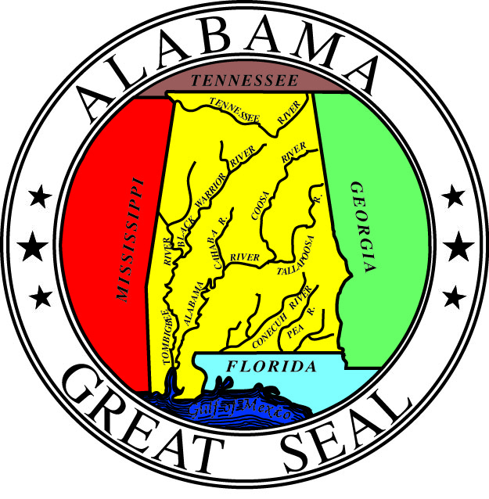
Main Street Alabama Revitalizer Investors

Slide 3
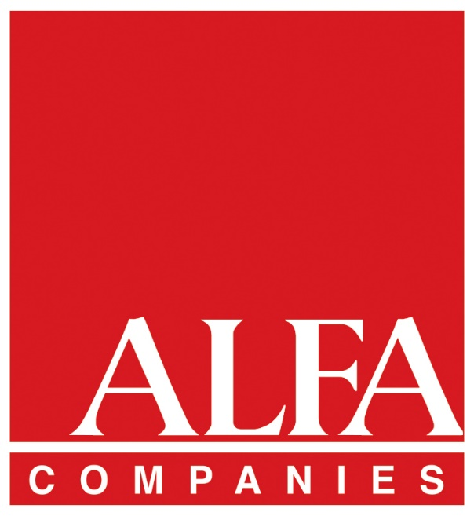
LAB Sponsors

Slide 4
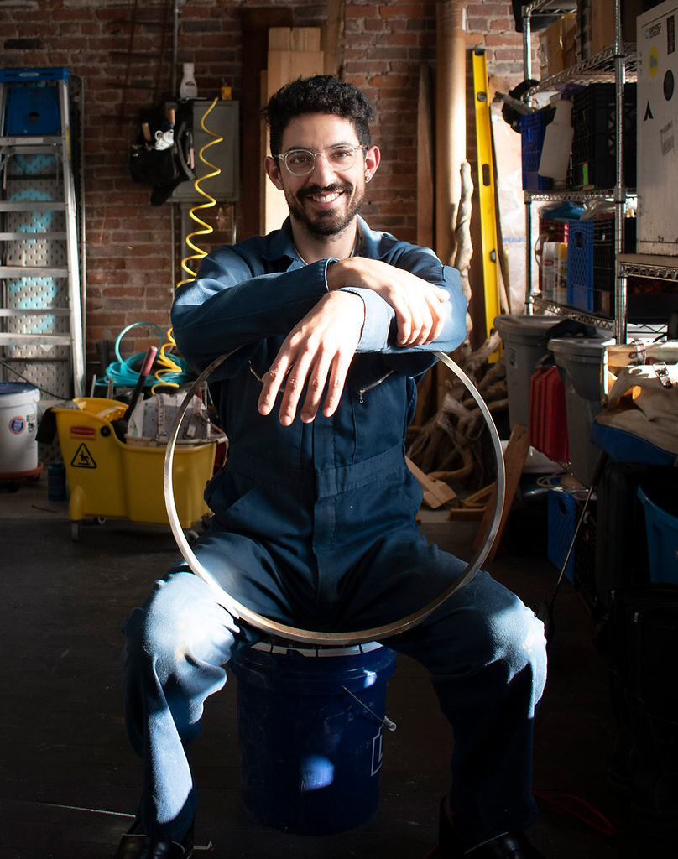
Sam Horowitz
Every year, Main Street Alabama selects an artist to create the piece given for the Main Street of Excellence awards. This year Sam Horowitz was chosen and made the nearly 50 awards.
In his words, Horowitz explains that he is a futurist, sculptor, professor, and mad scientist beginning his teaching at Rowan University in Glassboro, New Jersey this fall. He was an Artist in Residence and Shop Steward at Sloss Metal Arts in Birmingham until the end of this summer.
The awards he created for Main Street Alabama are the results of his current fascination with the ability of molten iron to record time. Each oval was poured open face, and Horowitz drew a tool through the casting before the iron had solidified. The window of time when this is possible is slim - if the iron is too hot, the metal fills in the mark like water swallowing a sandcastle. If the metal is too cool, it is as resistant to the tool as, well, iron. Thus, as each mark must be made in a specific moment, each award recognizes a specific achievement. By the unity of the physics and metallurgy that describes this process, all are joined in common purpose, and celebrated in their excellence and impact on the community.

Slide 5
Alice Bowsher Main Street Alabama Leadership Award
Award given in recognition to an individual or organization who has made an outstanding leadership contribution on a statewide basis.

Slide 6
Paul Carruthers
Paul served on the Main Street board in the early years – when Main Street Alabama was still forming our identity and becoming who we are today. His belief in the Main Street Approach is inspiring and he lives that in both his personal and professional life, giving of his time and expertise, always willing to listen and one of the first to say, “hey, I can help with that." He took the lead on the Development committee and is now co-chair of the Fundraising committee for Main Street Now – the National Main Street Conference coming to Birmingham in 2024. Paul has recently returned to the Board to serve another term.

Slide 7
Excellence in Fundraising
Award recognizes a Main Street program for outstanding local fundraising activity or campaign; displaying creativity and success in securing funds for the district, program, or specific project.

Slide 8
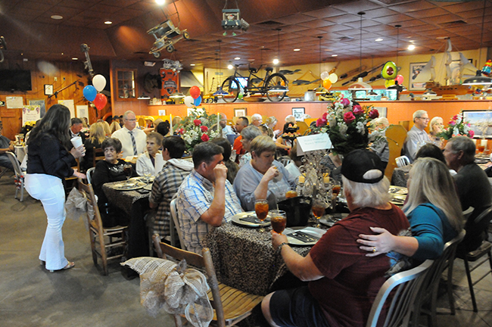
Atmore ∼ Celebrity Waiter
Celebrity Waiter is the largest fundraising event for Atmore Main Street. It enlists high-profile community leaders to act as waiters at one of their local favorite restaurants - David’s Catfish House. The event is designed to raise money and awareness of the Main Street Program, while creating nightlife in the city. The inaugural 2022 Celebrity Waiter Event proceeds totaled $30,903.69 and in 2023, cleared over $40,000.

Slide 9
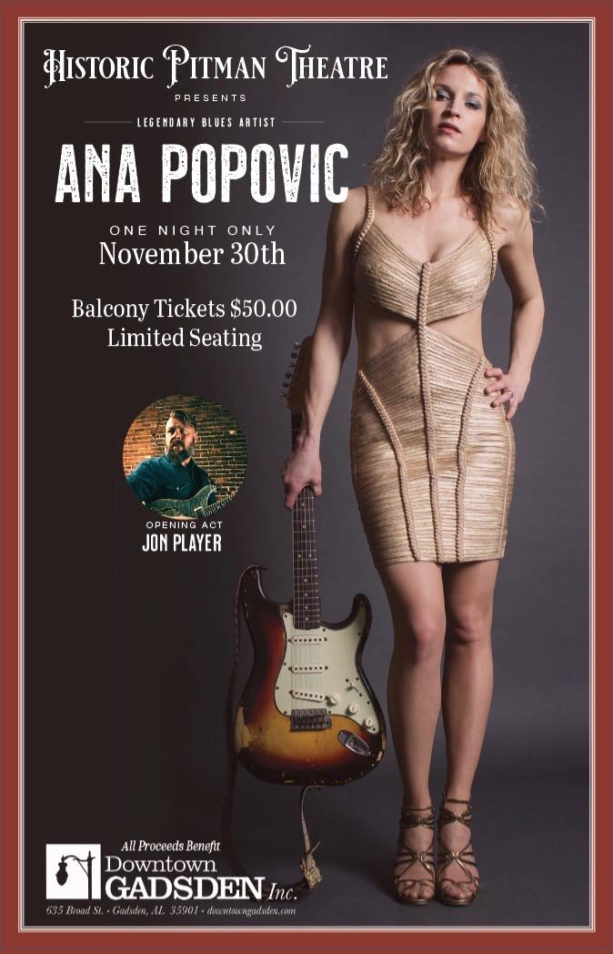
Gadsden ∼ An Evening at the Pitman
The goal of the evening was to bring quality entertainment to the Pitman Theatre while raising revenue for Downtown Gadsden, Inc., and the Pitman Theatre. Steve Gilbert, a downtown property owner, used his contacts in the music industry to bring Ana Popovic, a world-renowned jazz guitarist/singer, to the Pitman last November. After that successful event, he scheduled Damon Johnson, former guitarist with Lynard Skynard, Alice Cooper, and Thin Lizzy in April. The combined concerts cleared $22,000, $12,000 of that was reinvested in the Pitman, with new flooring for the expanded stage and other amenities.

Slide 10
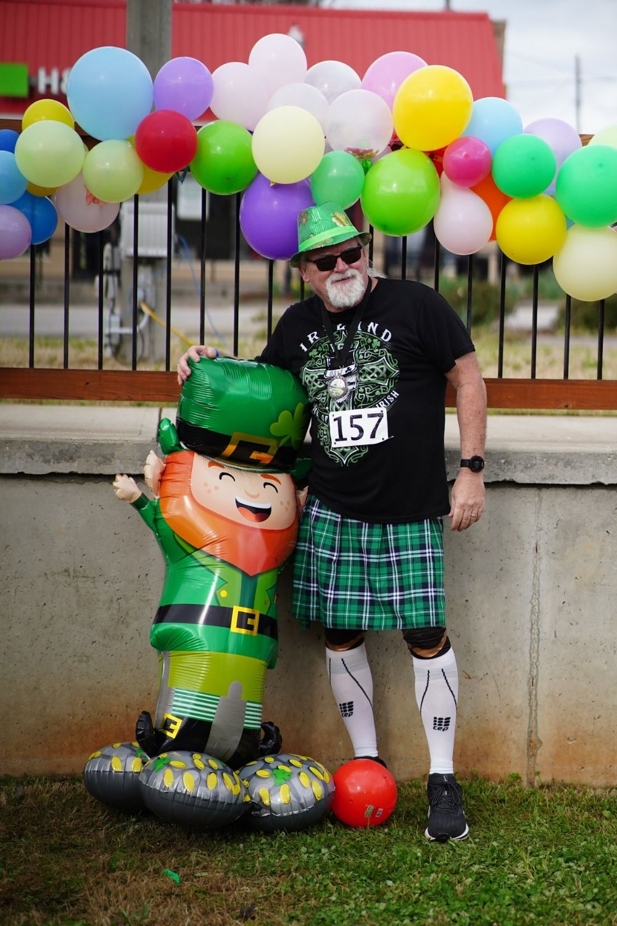
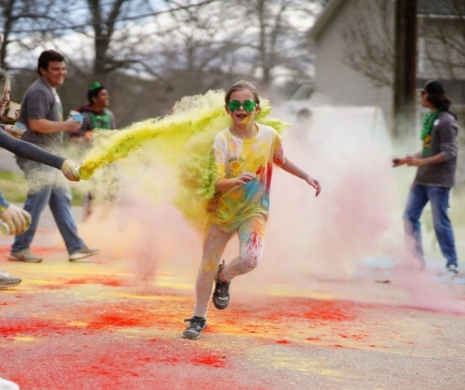
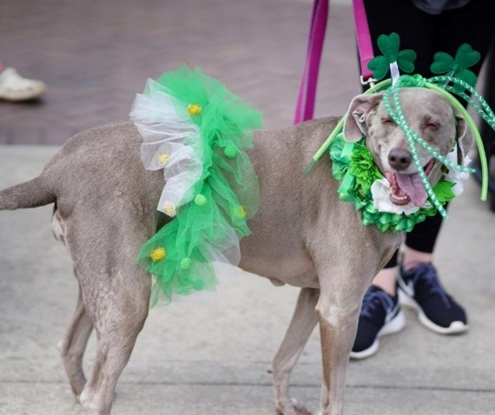
Heflin ∼ St. Paddy’s on Main
St. Paddy’s on Main is hosted in downtown Heflin in conjunction with the long-standing event, Strides of March 5K. Heflin Main Street expanded the event to include the St. Pawtrick’s Day Pet parade, Strides Color Run, live music, and a costume contest. The goal of St. Paddy's is to showcase the downtown district and to demonstrate that it can serve as an event space, to facilitate walkability and to help drive customer traffic into the downtown businesses. The goal was to raise $10,000, which they exceeded bringing in $11,713.66.

Slide 11
Excellence in Public / Private Partnerships
Award recognizes outstanding local partnerships between the local Main Street organization and another community entity or entities (public or private).

Slide 12
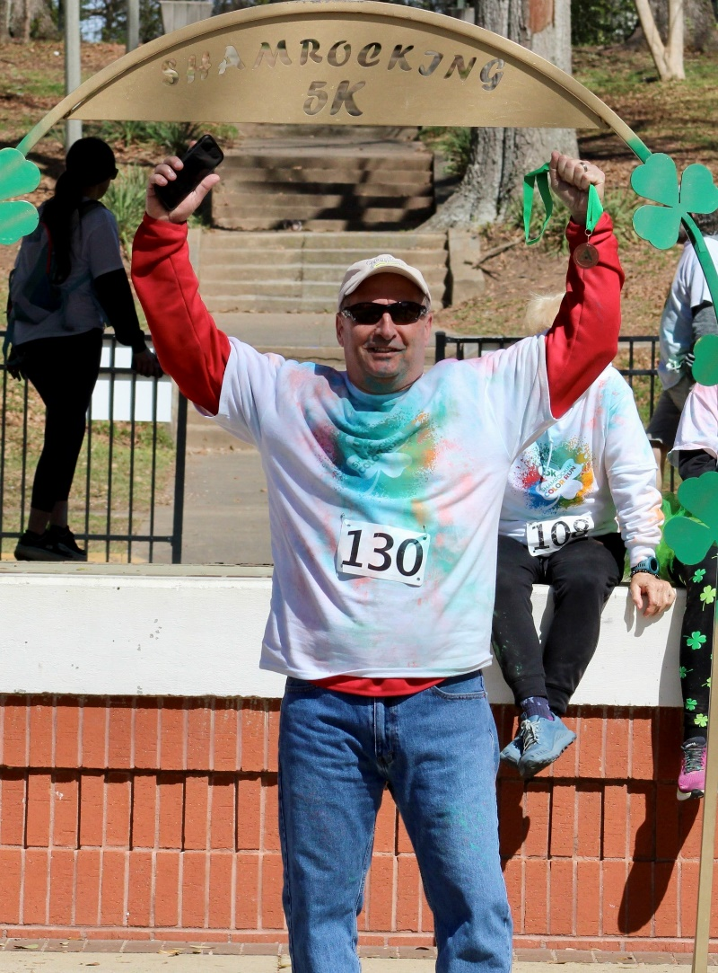
Anniston ∼ Sparklight and Main Street Anniston
Main Street Anniston and Sparklight have forged a local partnership on several levels, from donations, the Adopt a Block program, volunteer hours, and having a team member serve on the Board of Directors, the Sparklight partnership has been a true blessing to Main Street Anniston. Local Sparklight GM, Mike Ligouri connected with Main Street Anniston in the Spring of 2022 to discuss what was in the plans for the future of downtown, with their office located near the Main Street district, Mike was interested in seeing things develop. Main Street Anniston looks forward to working with them to grow a Main Street Membership program for outside donations.

Slide 13
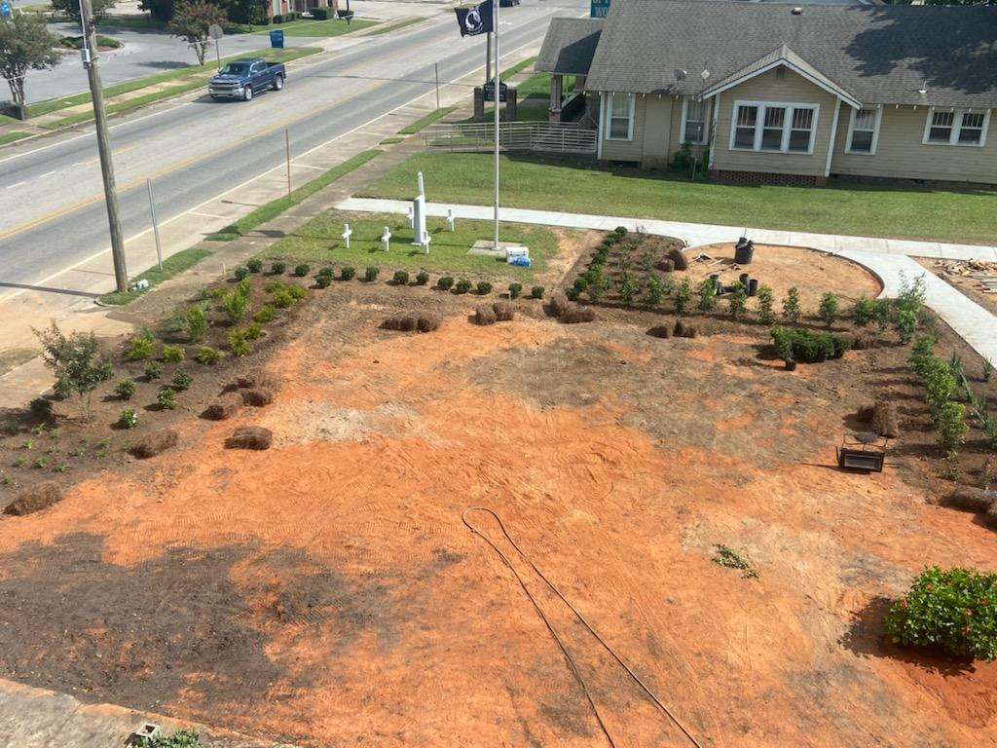
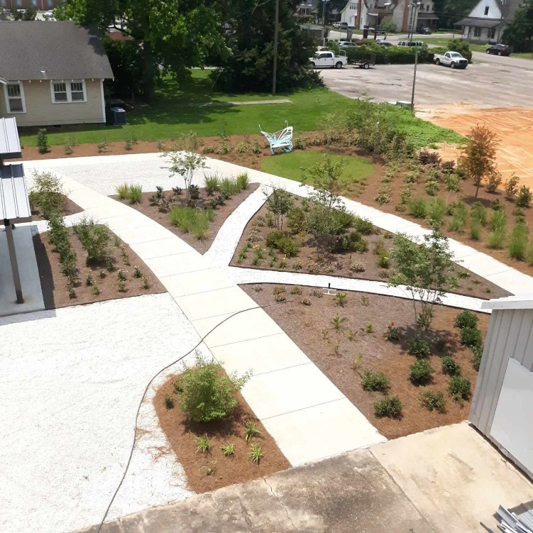
Atmore ∼ American legion Pollinator Garden
The American Legion #90 in Atmore is the Veterans' non-profit housed in the downtown district. The Legion actively honors Atmore through a myriad of positive outreach activities by building partnerships to create sustainable change. Recently by connecting existing physical assets and creating specific partnerships among; Main Street Atmore, Pride of Atmore, United Fund; Poarch Creek Band of Indians, City of Atmore, Alabama Department of Agriculture, Escambia Soil Conservation, Gulf Coast RC&D; local banks, ALFA, T-Mobile, & foundations, a beautiful multi-functional garden adorns the downtown in a previously blighted area.
In Progress
After

Slide 14
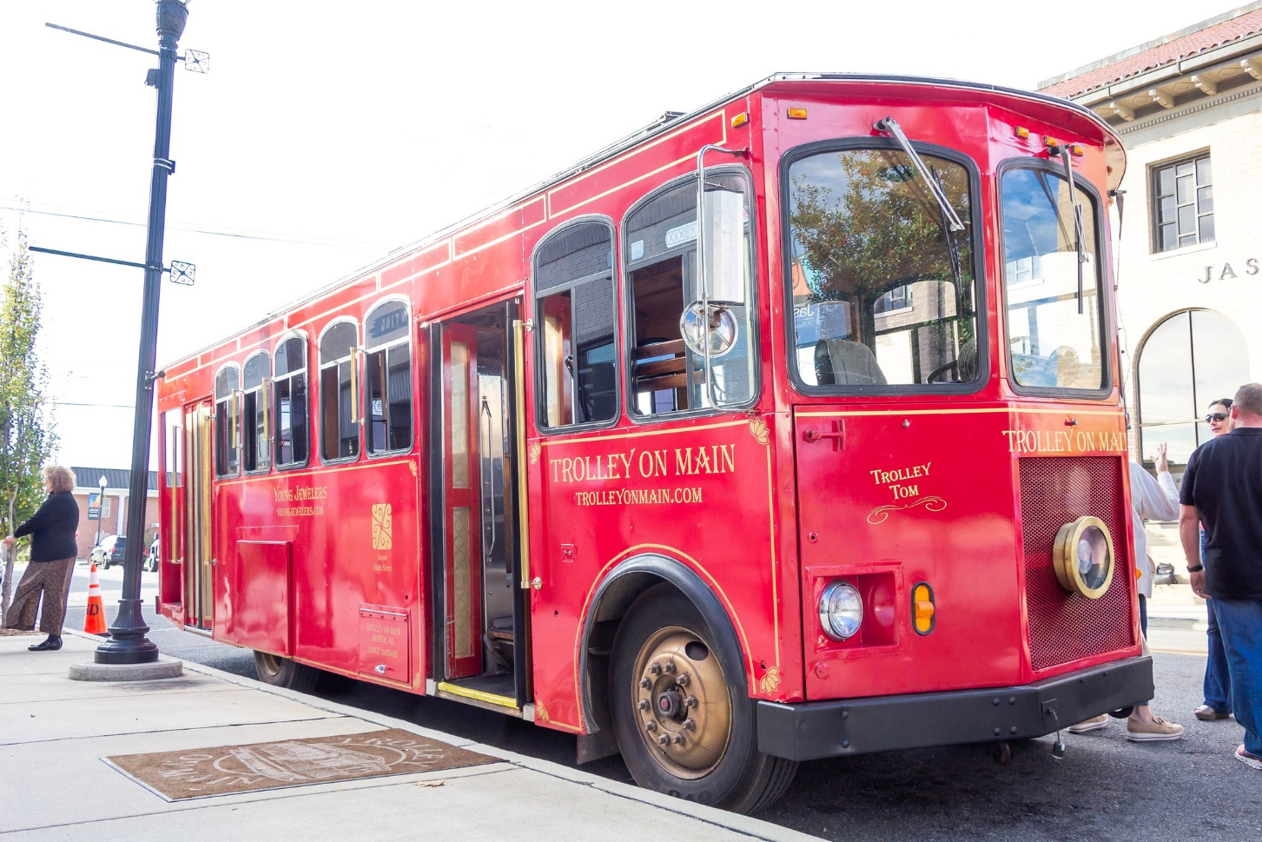
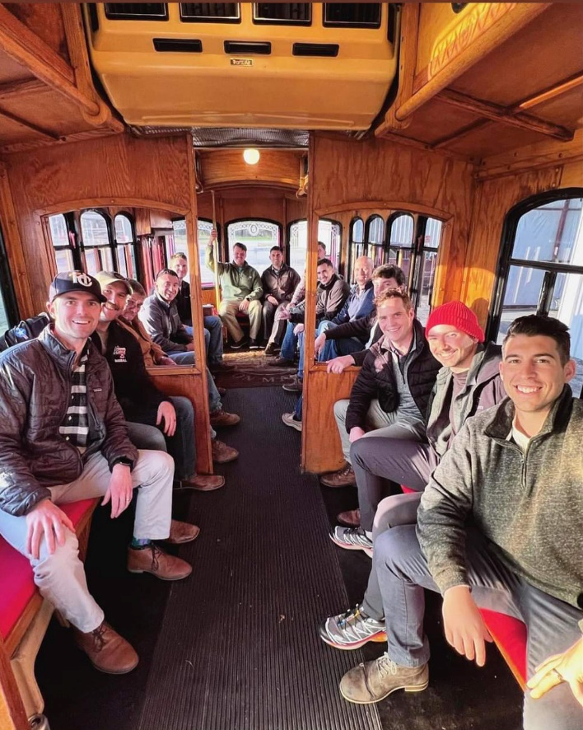
Jasper ∼ Trolley on Main (TOM)
A local downtown business partnered with Jasper Main Street to bring a fully refurbished trolley to Downtown Jasper. Trolley on Main (TOM) provides a unique opportunity for Jasper Main Street to showcase the beautiful downtown and transport guests and potential investors throughout the district. As a separate for-profit business, Trolley on Main is available for weddings, corporate outings, holiday events and celebratory milestones with friends and family. The goal is to create lifelong memories aboard Trolley on Main in and around Downtown Jasper!

Slide 15
Excellence in Volunteer Development
Award recognizes outstanding local Main Street program volunteer recruitment, training, and recognition.

Slide 16
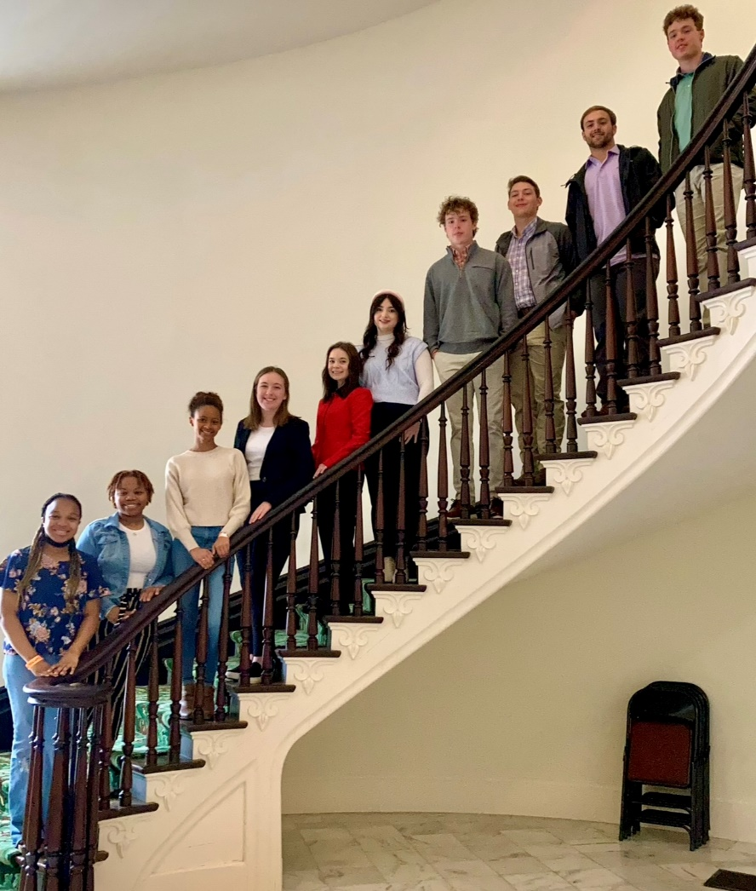
Elba ∼ Main Street Junior Ambassador Program
The Elba Junior Ambassadors Program is a youth-led initiative that engages students in the economic development of their community. The program's purpose is to; inspire students to be active citizens and community leaders, educate students about the importance of Main Street and economic development, foster a sense of civic pride and ownership in the community, and develop students' leadership, communication, and teamwork skills.

Slide 17
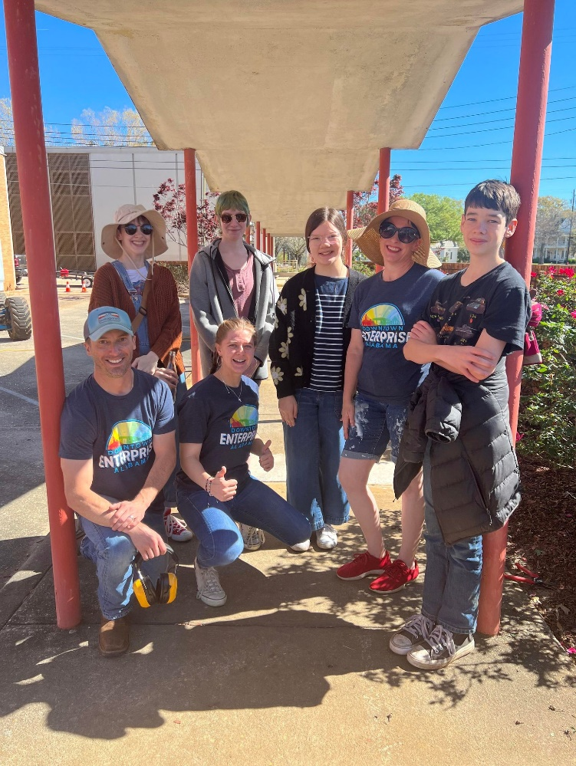
Enterprise ∼ Young Main Street Committee
The Main Street Enterprise Board developed a "Young Main Street" committee which consists of individuals as young as age 14 who are interested in participating in Main Street projects. Since the Fall of 2022, the Young Main Street committee has completed three projects under the general advisement of the corresponding Promotion and Design Chair, including painting the Small Box Shop prior to the launch in Spring 2023.

Slide 18
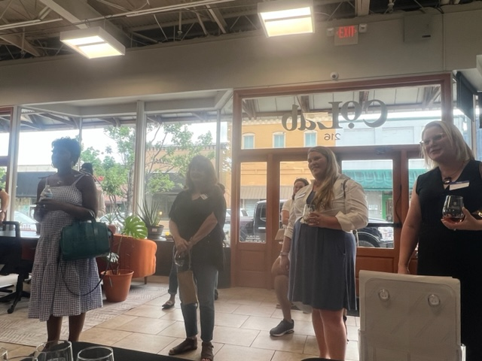
Opelika ∼ Opelika Main Street Volunteer Reception
Opelika Main Street hosts a reception for current and aspiring volunteers. They provide food, beer, wine, and lots of information on how to be a part of Opelika Main Street. The reception was promoted over a month-long timeframe through social media, broadcast news outlets and local print publications. The reception is put on to explain what Main Street is all about to those who aren't familiar with their mission and vision. They educate attendees on the Four-point approach and what it means to be a part of Main Street. They gained 20 new volunteers from the first event.

Slide 19
Excellence in Promotion
Award recognizes outstanding special events/activities that promote the Main Street district by creating a quality authentic event which generates traffic for the district.

Slide 20
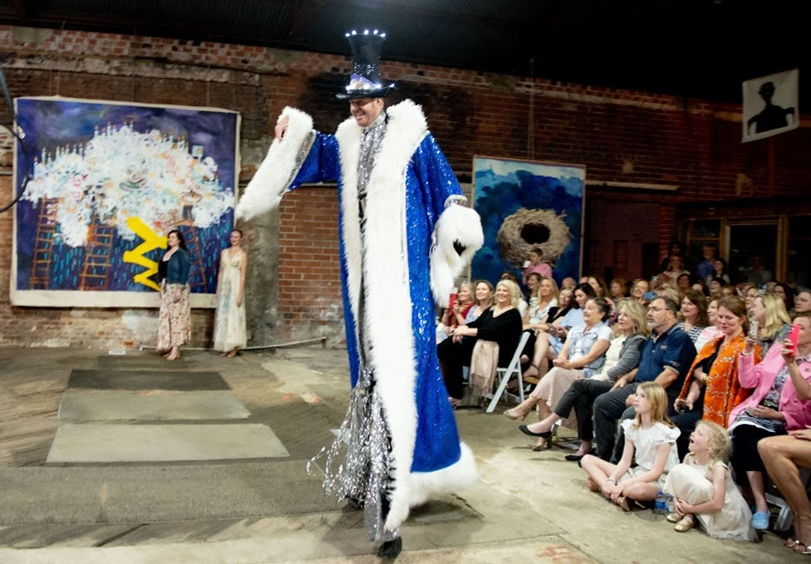
Eufaula ∼ A Vintage Affair
Held in the heart of downtown Eufaula, this event turned locals and Pilgrimage visitors upside down. The former hardware store was transformed into a modern-day art show, charcuterie room, vintage fashion show, Cirque du Soleil feel of entertainment wrapping up with a gospel choir finale. This event was added to the annual tour of homes for a fresh take on a vintage presentation. The event sold out in less than 10 days creating even more curiosity for next year from those who didn't get to the ticket booth in time.

Slide 21
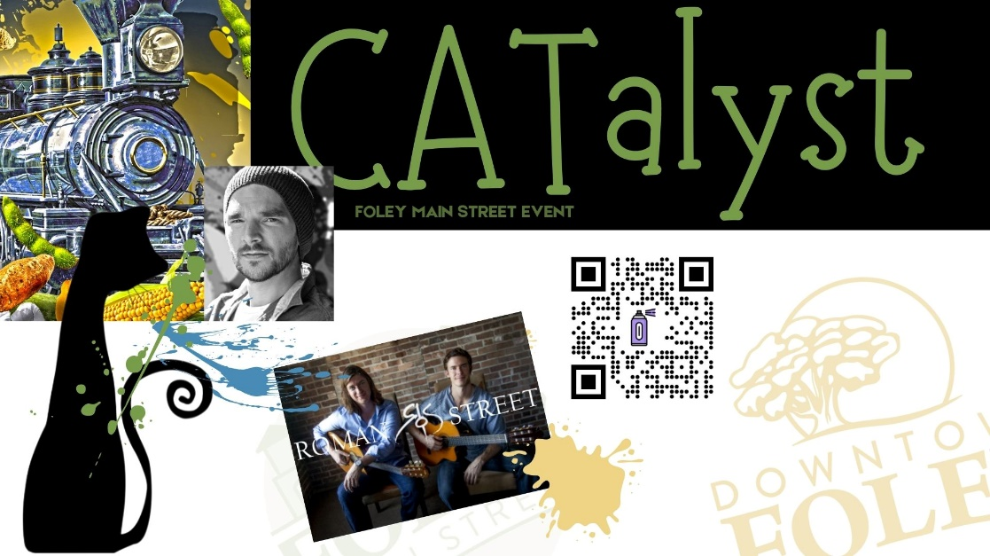
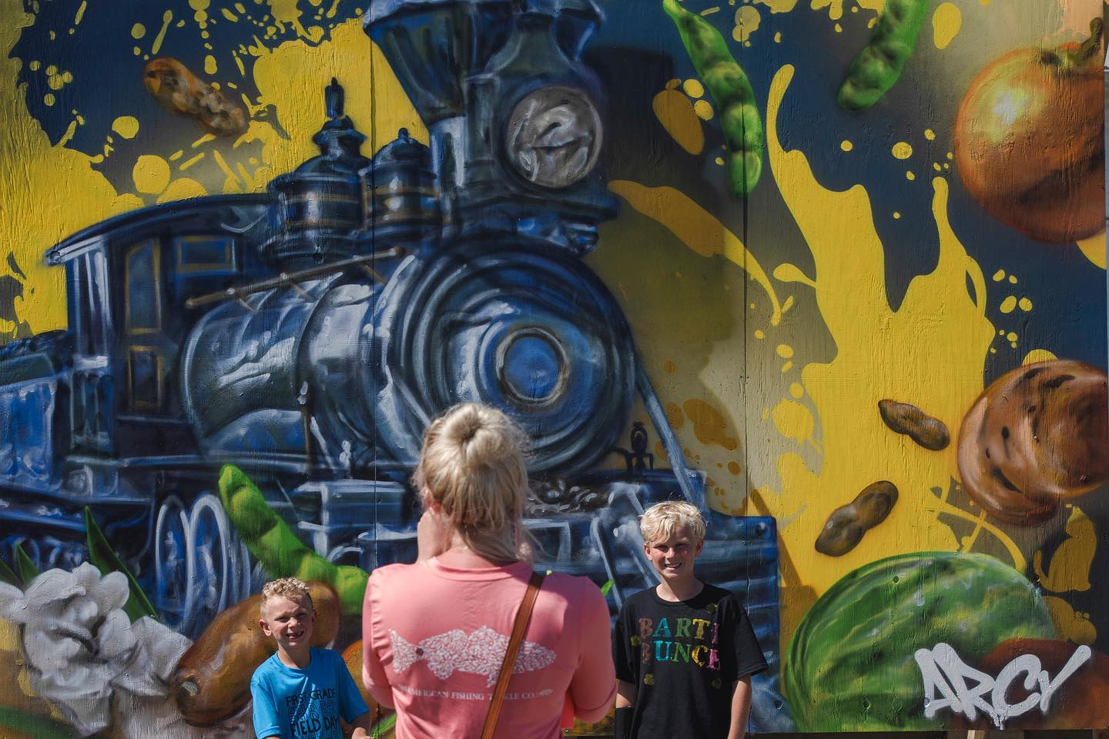
Foley ∼ CATalyst
The CATalyst event kicked off Cat Alley, a Foley Main Street public art initiative, held in the heart of downtown Foley, featuring artist ARCY painting the first mural that includes a hidden cat. Tunes by local DJs and classical guitar players, delicious lunch options under cozy tents, and a bar for those craving a drink set the stage. Cat alley swag was also sold. Foley Main Street had 1,500 entries in the Cat Alley elementary school art contest. Three thousand sets of flyers and color sheets went out to parents and teachers which enhanced the promotion of Catalyst. Over a thousand attended.

Slide 22
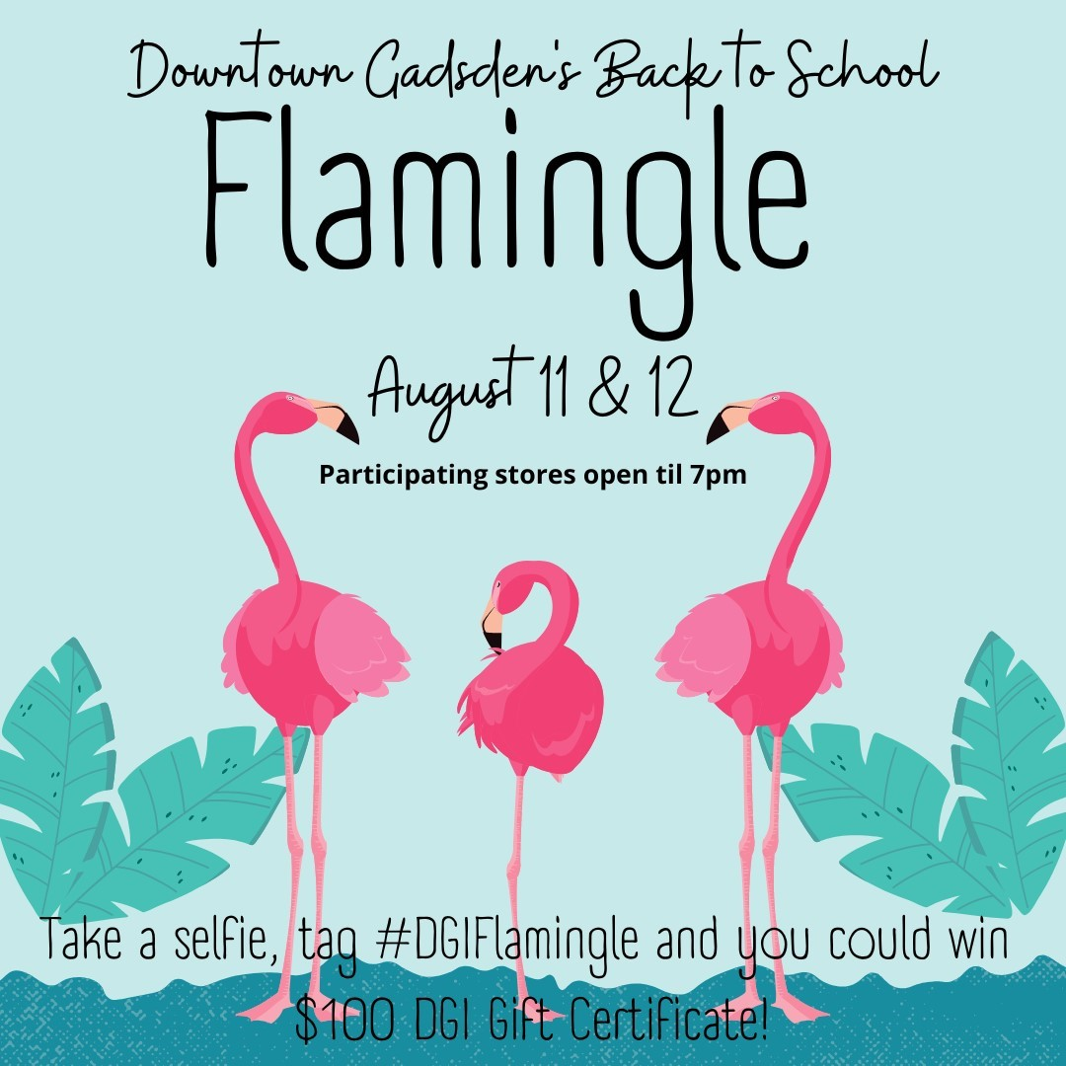
Gadsden ∼ Back to School Flamingle
During a merchants' meeting, there was a discussion regarding a possible "Back to School" event. It was decided that the businesses could "Flamingle" to be colorful and fun for all! Downtown Gadsden, Inc. committed to purchase the necessary decorations and the stores committed to have extended hours to entice people to come downtown to shop and dine.

Slide 23
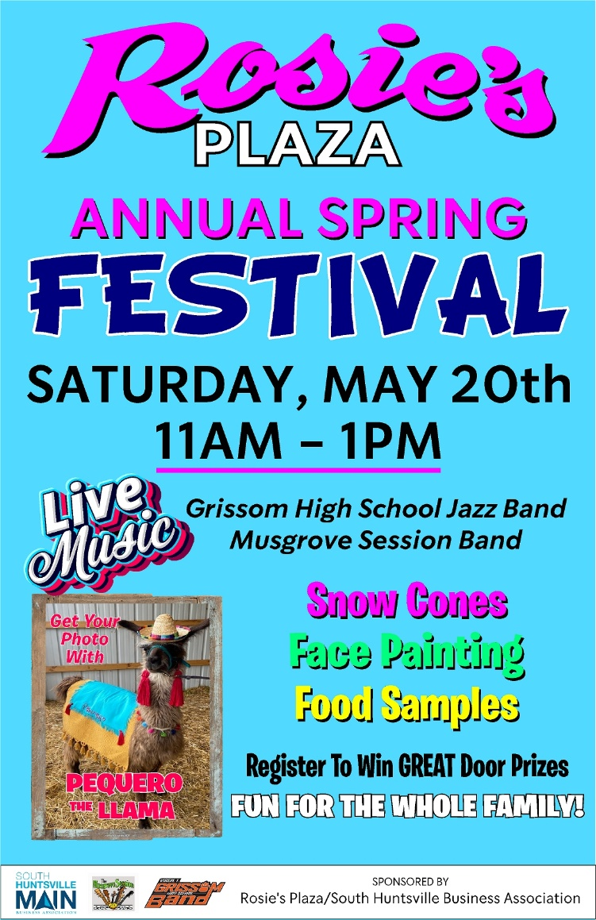
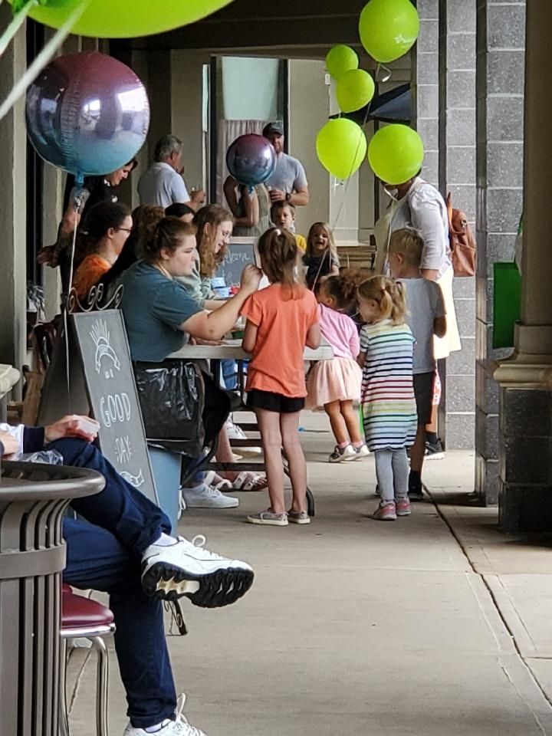
South Huntsville ∼Rosie’s Plaza Annual Spring Festival
Hosted at Rosie's Plaza shopping center at the northern border of the South Huntsville Main Street district, Rosie's Plaza Annual Spring Festival draws hundreds of residents to visit local businesses while enjoying local music, face painting, snow cones, giveaways, and even pictures with a llama. This family event showcases Huntsville's favorite Tex-Mex and pizza eateries, fitness and nutrition centers, hobby stores, veterinary hospital, financial advisors and more. Guests of all ages were able to engage with local businesses to meet all their family's needs!

Slide 24
Excellence in Marketing
Award provides recognition for outstanding efforts by a local Main Street organization to promote the entire district as a destination or a branding or image development campaign.

Slide 25
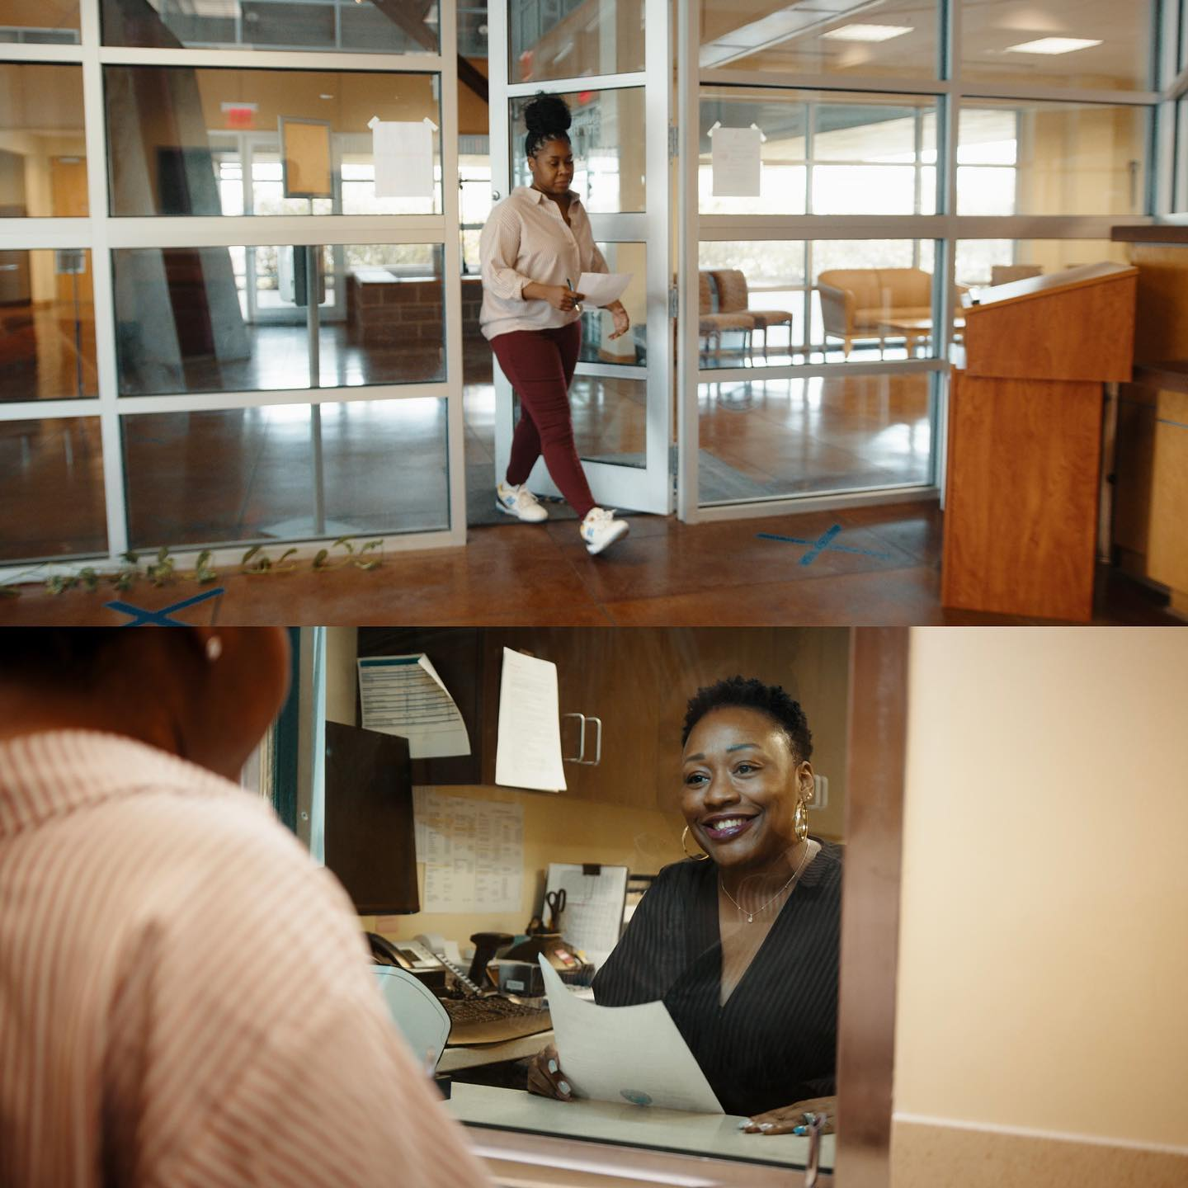
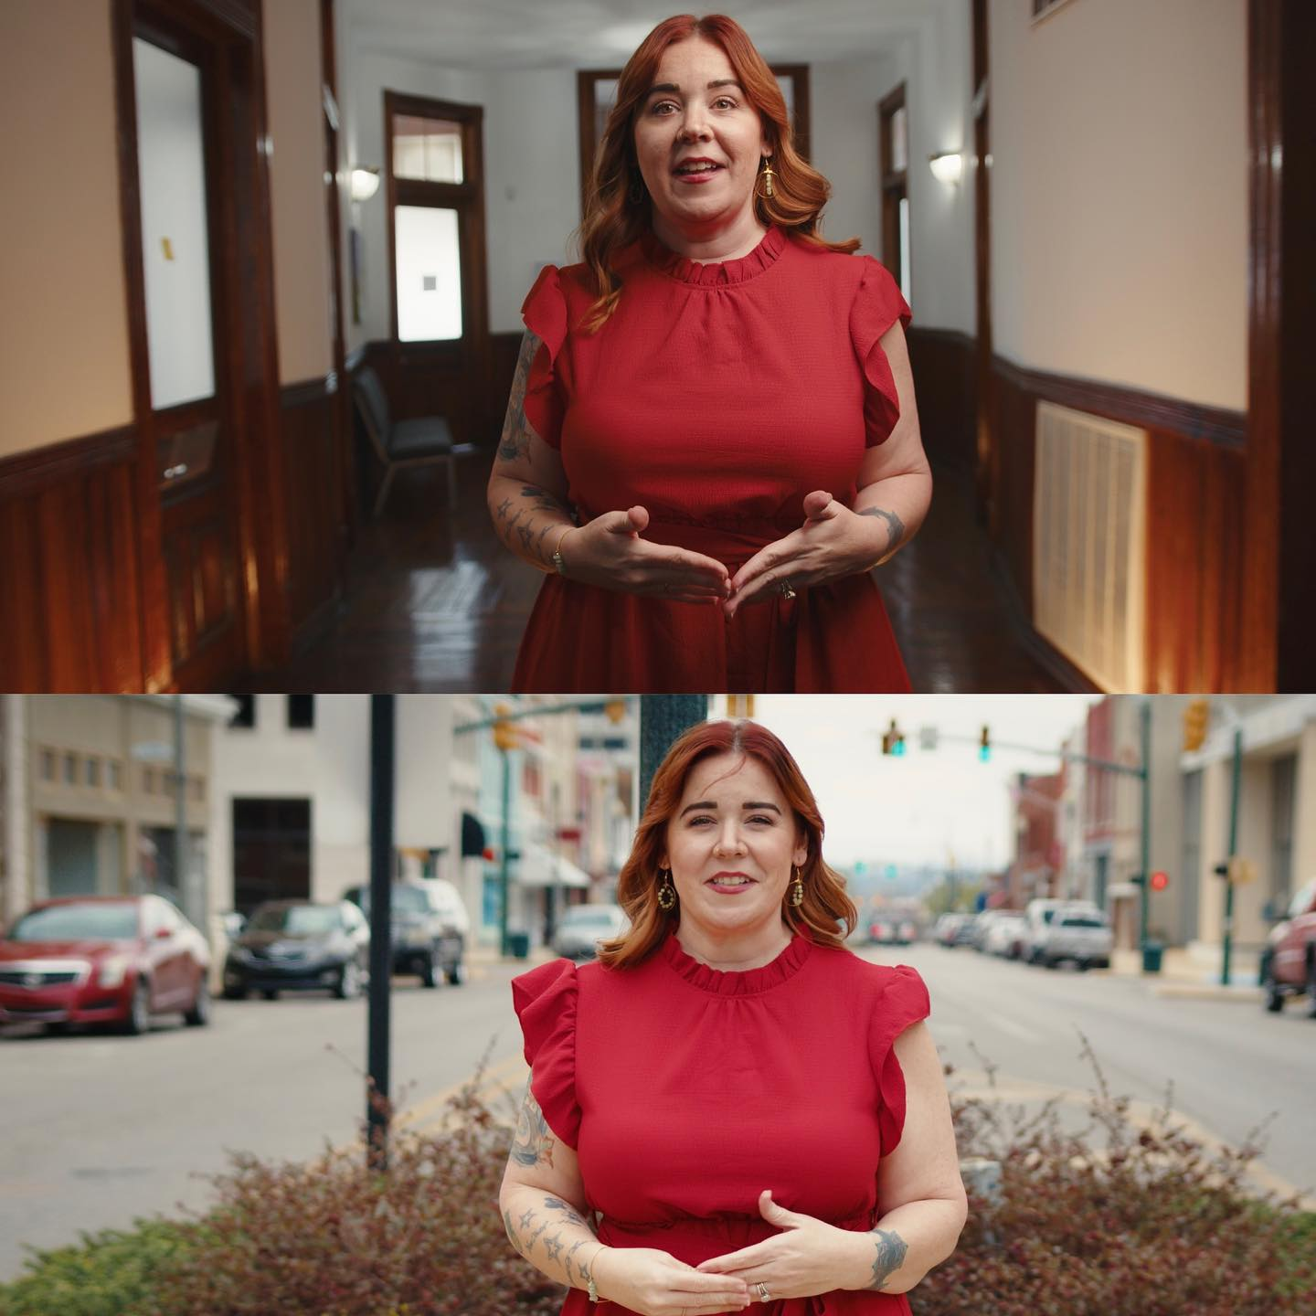
Anniston ∼ Main Street Minute
The Main Street Minute is a monthly video series that addresses various topics in Downtown Anniston - from how to start a business, to upcoming events, and welcoming new neighbors. This video is a brief one minute ”infomercial" that is based off whatever information needs to be promoted that month. It is distributed to business and property owners through their monthly e-newsletter and to the community through social media accounts. They have found they are reaching a generation that will watch a quick video as opposed to scrolling past a body of text.

Slide 26
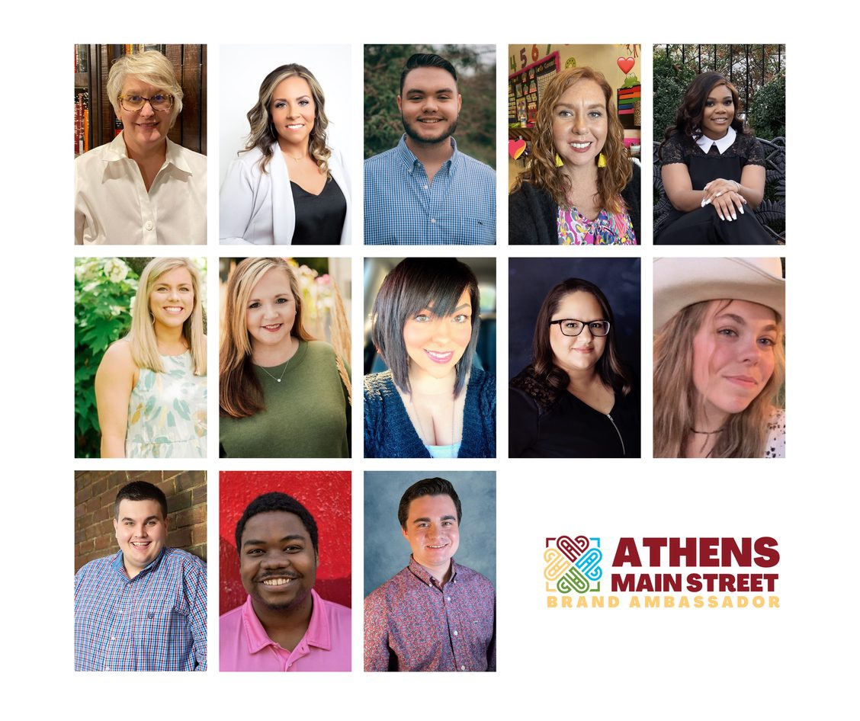
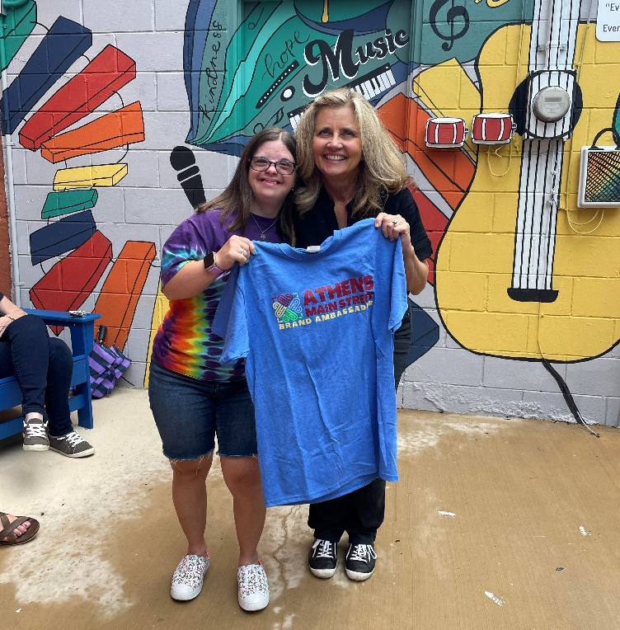
Athens ∼ Brand Ambassadors
The Athens Main Street Brand Ambassadors have spent the year capturing unique and authentic experiences downtown. Through their efforts, they showcased merchants, restaurants, events, and even suggested those unique experiences that only downtown insiders know about. The ambassadors consist of a diverse group of high school students, parents, young professionals, and business owners. Also, key to the program is that all areas of Limestone County are represented by an ambassador.

Slide 27
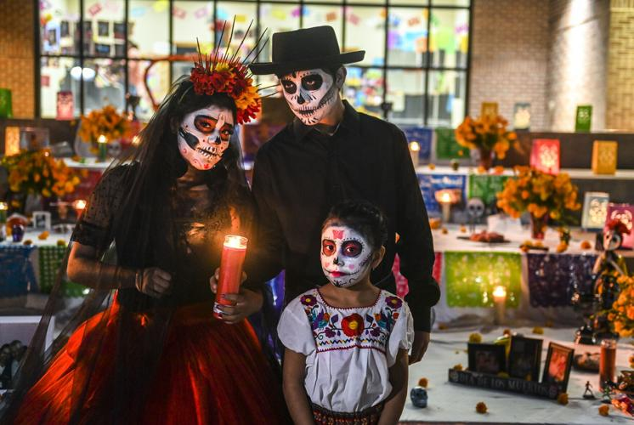
Decatur ∼ Welcoming & Inviting Dia de los Muertos
Downtown Decatur had been told by Hispanic committee members that the Hispanic community did not feel welcomed downtown. The event’s goal was to resolve that issue by welcoming and inviting them to downtown and the Bank Street districts. The event was marketed through the local elementary schools, Facebook, Instagram, news/media outlets, radio (Spanish and English stations), and printed flyers. They had over 3,500 attendees! The Hispanic committee members said that they thought the event was a huge success and that so many of their friends and family members spent time in Downtown for the first time ever. The event also made it possible for regular downtown goers to meet their Hispanic neighbors. Non-Hispanic event attendees loved the event and learning more about their Hispanic neighbors. Dia de los Mertos was a true coming together and a bridge of culture and community.

Slide 28
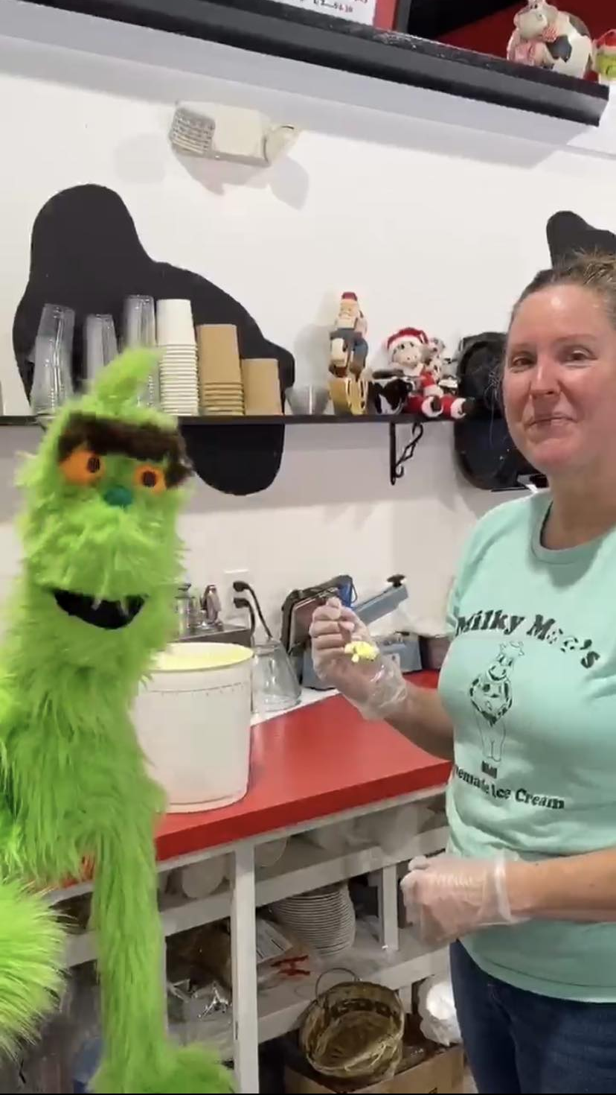
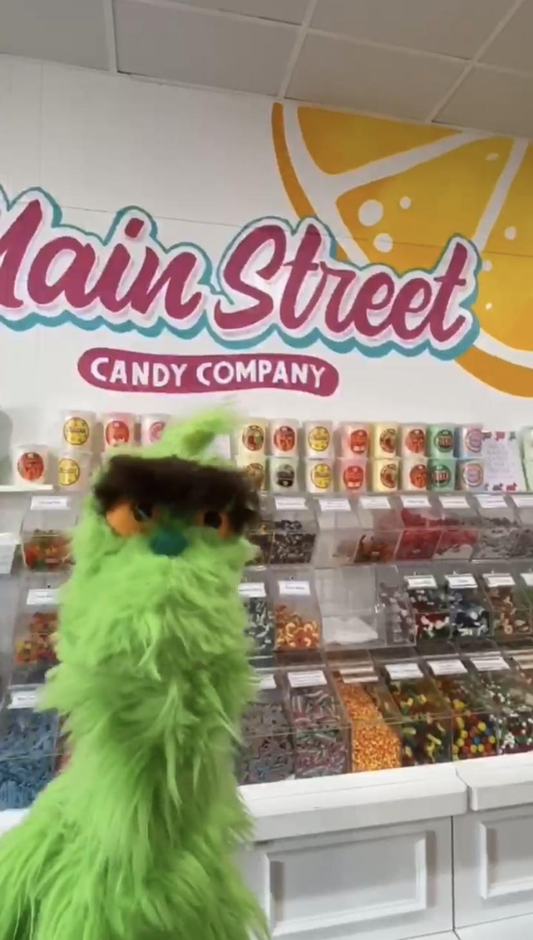
Enterprise ∼ Grinch Puppet Marketing
One of the Enterprise Young Main Street committee members designed and handmade a Grinch puppet to use for Downtown promotions during the "Who-lidays,” Enterprise's month-long Dr. Seuss-themed Christmas festival. The target audience was younger people, teens and tweens. Young Main Street hoped to draw a younger crowd to the 2022 festival, particularly to the opening weekend and the Scavenger Hunt a week before Christmas. Marketing platforms used were Instagram and Facebook. Ben, a Young Main Street committee member and his mom wrote a Seuss-style poem and filmed all over the downtown, tying the poem to the locations shot.

Slide 29
Excellence in Creative Promotion Idea
Award in recognition of Main Street Alabama programs that just got creative.

Slide 30
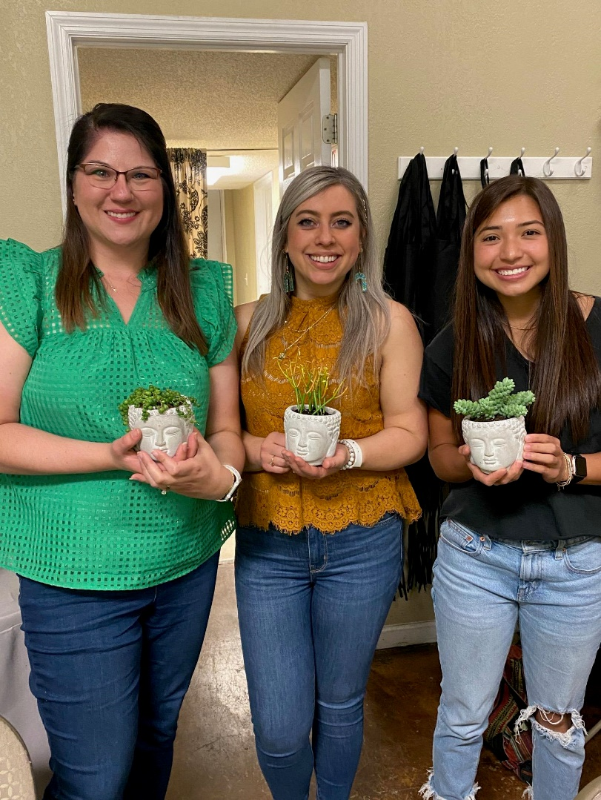
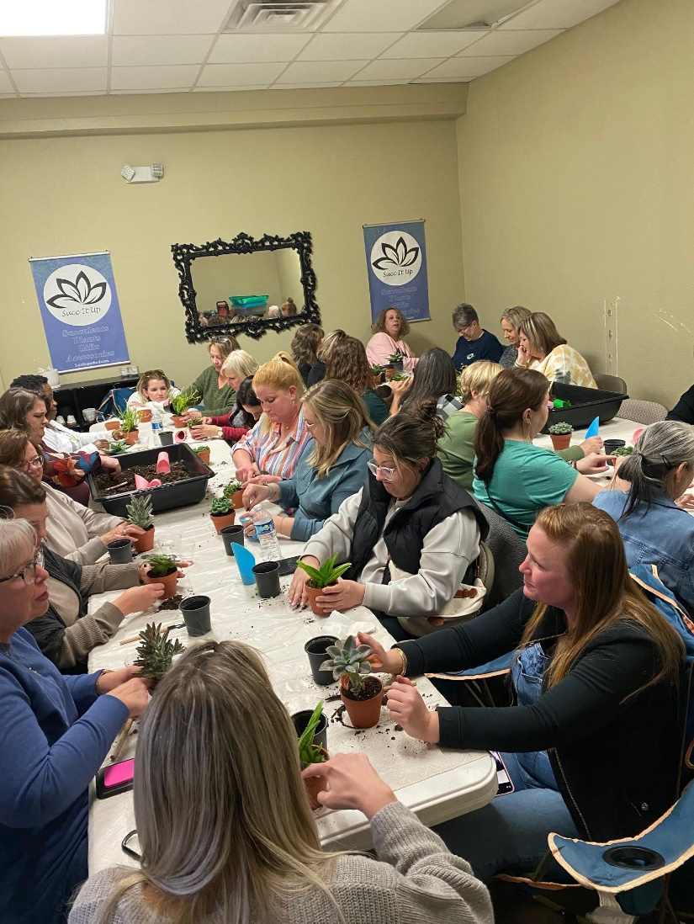
Oxford ∼ Sips and Succs
Sips & Succs is a workshop where participants are provided a plant, pot, and instructions on how to care for succulents. Wine and charcuterie are also provided. Local artists get in on the fun too. Sips & Strokes is a painting class taught by a local artist, JC Morgan. “Paint a Pot” events are where participants are taught to paint their terra cotta pots using an alcohol ink process, led by local artist Amber Simpson. Other events regularly offered are “permanent jewelry” by local artist Forever Yours by Christina, and Sip & Shop on Thursday evenings.
The overall goal of these events is not just to raise awareness and sales numbers of Succ It Up, but to build a true community and raise awareness of Historic Downtown Oxford.
Before
After

Slide 31
Excellence in Business Promotion
Award provides recognition for outstanding efforts by a local Main Street organization to improve the business climate, support, strengthen, retain, and attract businesses in the district.

Slide 32
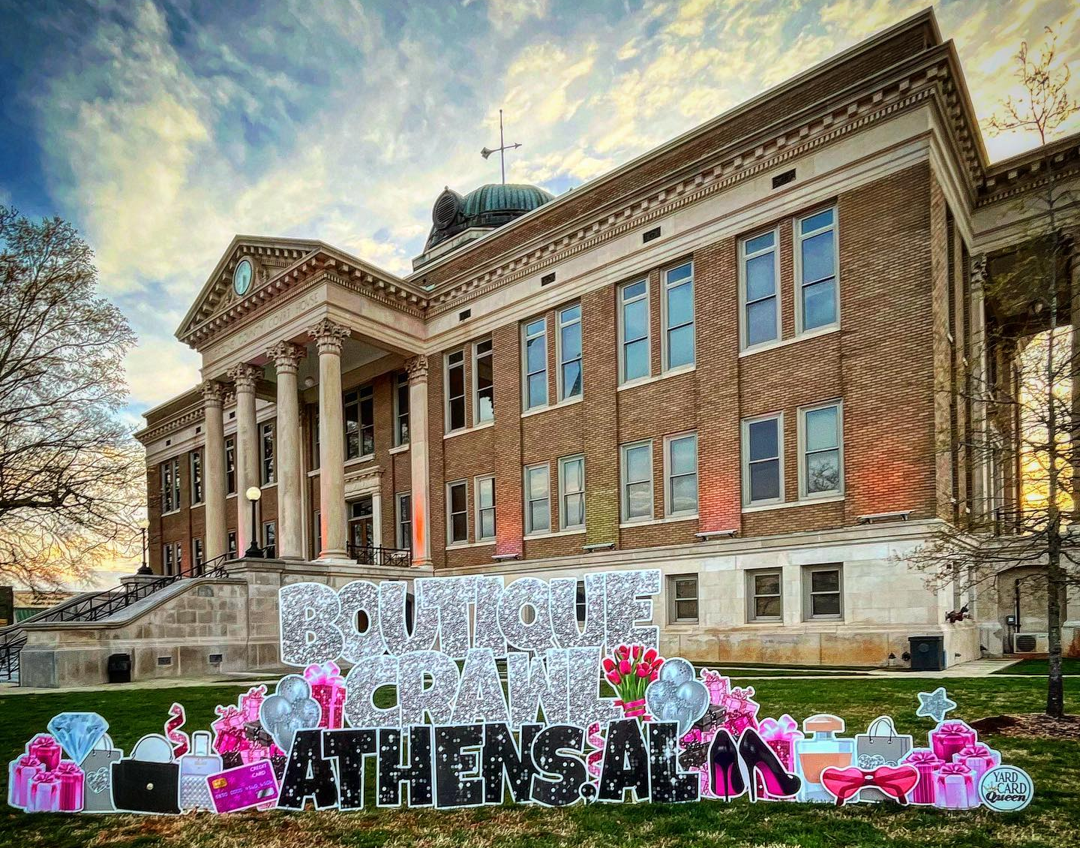
Athens ∼ Boutique Crawl
Eighteen downtown Athens clothing and gift boutique owners opened their doors to welcome patrons into their shops for major specials and sweet surprises during the Boutique Crawl. The clothing boutiques had new Spring lines out and the gift boutiques had new items to refresh homes after the long winter. For each purchase over $20, patrons could enter a chance to win a $500 shopping spree downtown sponsored by Dream Key Real Estate. The link to enter was created with Survey Monkey and a QR Code. Photos of sales receipts were uploaded and calculated by the Survey Monkey app. The total reported was just over $30,000 for the day.

Slide 33
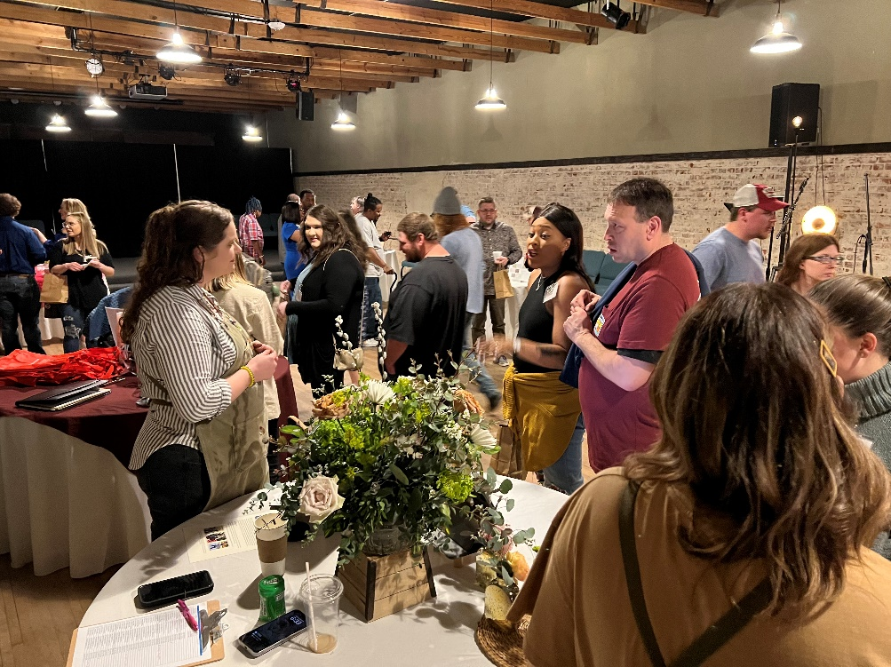
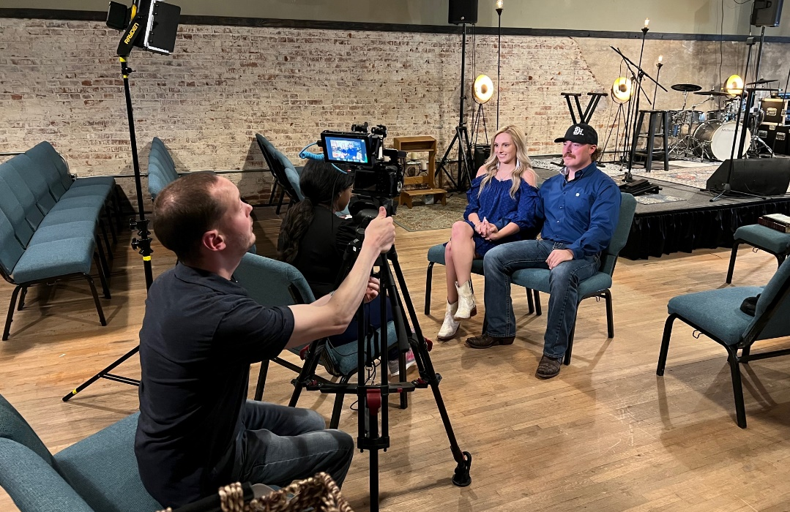
Calera ∼ Let’s Get Married on Main Street! Contest
Calera has a beautiful event center that very few people know about. In an effort to promote it as a wedding venue, a campaign was created to show Calera as a one stop shop for wedding planning. Let’s Get Married on Main Street was a complete wedding package giveaway for one lucky couple valued at over $20,000. Sixteen businesses participated in the contest by donating their goods and services. Fifty couples were selected to participate with the winning couple getting married the following September. The goals were to boost Calera Main Street social media following, gain exposure for the merchants, and document it to have quality marketing materials for future use to advertise Calera weddings.

Slide 34
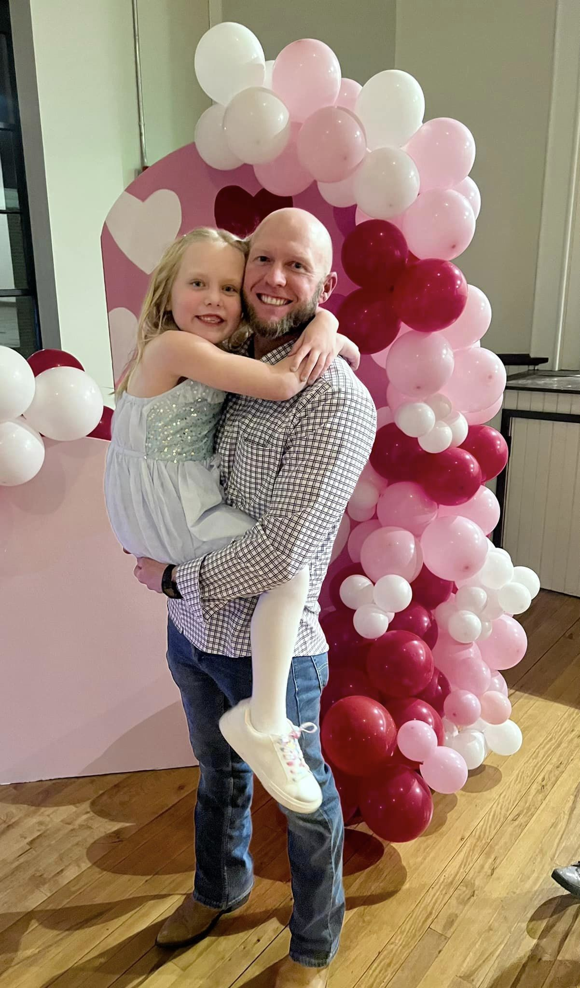
Heflin ∼Me and My Guy Shop and Dine
Heflin Main Street adopted a mission to create events that targeted new and specific groups. The first of those events took place in February of 2023 with the creation of "Me and My Guy, Shop and Dine.” This event was created with fathers and daughters in mind. Several downtown shops kept their doors open later than usual, created event specific promotions, and offered creative experiences during the event. Each time the registers rang to the tune of $10, shoppers earned a chance to win a grand prize at the end of the night. The event was well attended with sales being estimated by using a punch card system. Merchants reported increased foot traffic outside of normal business hours and first-time interactions with several shoppers. This magical night concluded with a candlelight dinner and dancing.

Slide 35
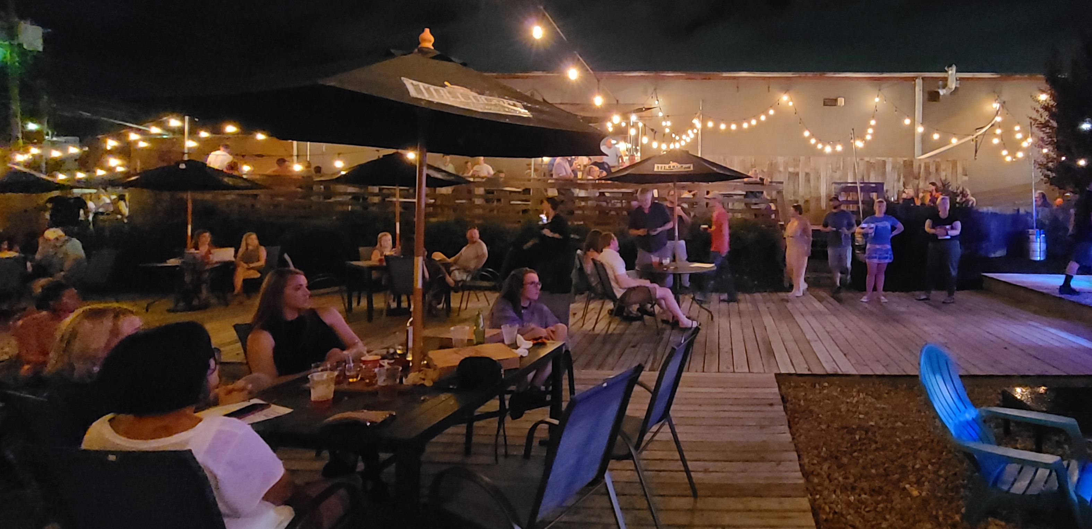
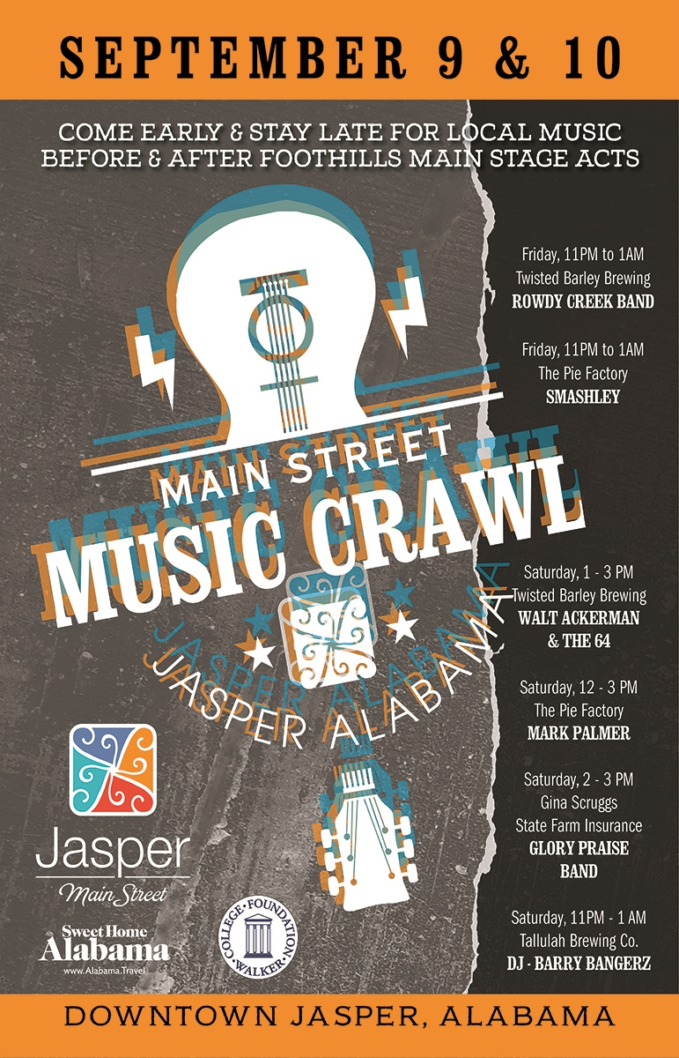
Jasper ∼The Music Crawl
The City of Jasper annually hosts a free two-day music festival in Downtown Jasper, the Foothills Festival which attracts 20,000 people to the district. Jasper Main Street wanted to give restaurants and breweries an additional opportunity to take advantage of the extra foot traffic in the downtown from this event. The Music Crawl was created to place local musical talent in downtown venues before and after the main stage acts. The music crawl enabled attendees to continue their evenings at local restaurant/ bars and breweries. A diverse selection of music genres was selected featuring 6 different musical acts throughout the weekend. All downtown businesses were open during the festival and enjoyed a substantial bump in revenue over the two-day event with Tallulah Brewing seeing a 265% increase in sales over the previous year without the Music Crawl.

Slide 36
Excellence in Business Development
Award provides recognition for outstanding efforts by a local Main Street organization to improve the business climate, support, strengthen, retain, and attract businesses in the district.

Slide 37
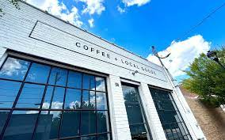
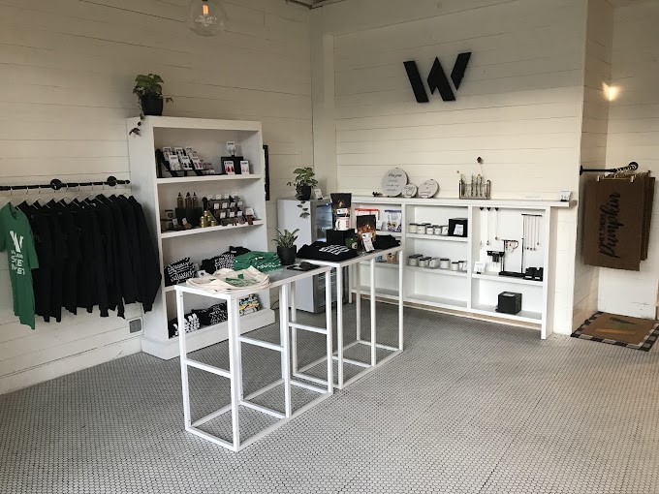
Birmingham (REV) ∼ Woodlawn Marketplace Business Incubator
The Woodlawn Marketplace business incubator offers a platform for women and minority entrepreneurs to move from selling occasionally in markets or online to a shared retail space with other growing businesses without having to sign binding leases or long-term contracts. The Marketplace features coffee, breakfast, lunch, and retail products from local entrepreneurs. The goal of the program is to grow tenant businesses to a stage where they are ready to pay market-rate operating costs. Current tenants include 3 anchor businesses and 8 to 12 retail vendors.

Slide 38
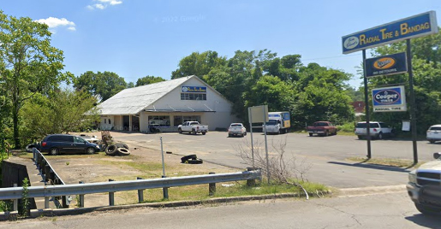
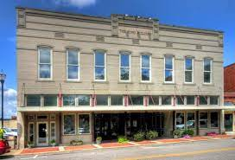
Jasper∼ Downtown Incentives
As Jasper Main Street continues to landbank properties, they have also begun to offer incentives to spark more interest in purchasing buildings and to start businesses in the downtown district. Specific examples include:
Radial Tire, a shop that serviced large trucks, needed a Phase one ADEM study and cleanup. Jasper Main Street funded that expense at $8,000 and then offered that as an incentive to purchase the building. The building has now been purchased.
King Law Firm, one of the largest buildings in Downtown Jasper, needed a structural engineering study. Jasper Main Street funded that expense as an incentive. The study was provided to the now new owner.
Jasper Main Street continues to connect properties with buyers and offering education and support for compliance especially with restaurants. Currently they are assisting in getting all restaurants in compliance with the FOG (fats, oils, grease -- grease trap) Policy with the Jasper Water Works and Sewer Board.

Slide 39
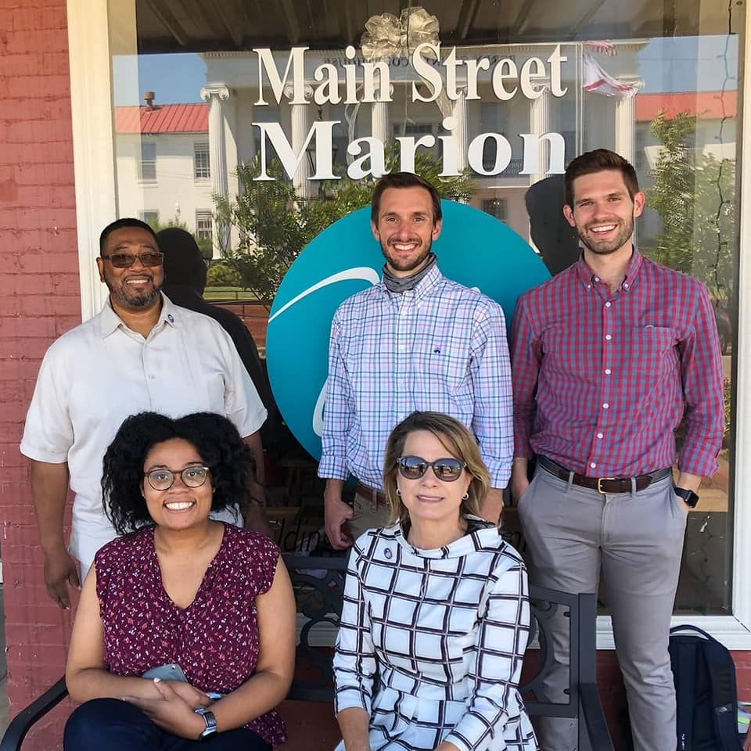
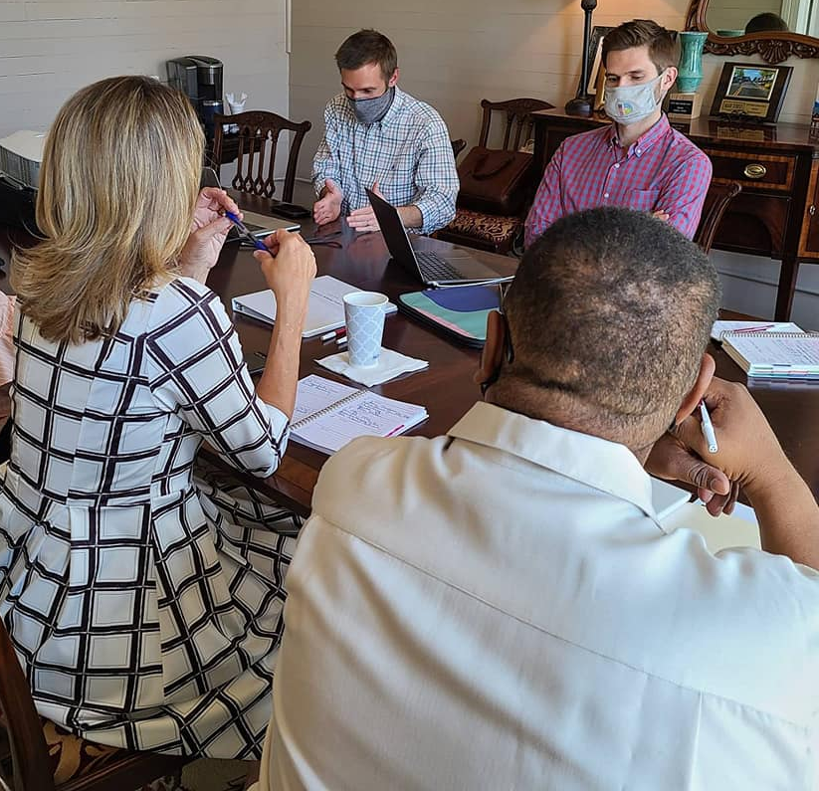
Marion∼ USDA Loan Revolving Fund
Marion Main Street worked with Opportunity Alabama to apply for and was awarded a USDA Revolving Loan Fund Grant for $150,000. The specific goal of the funding requested was to encourage and assist local small businesses owners and entrepreneurs in Marion interested in upgrading equipment and facilities and/or starting up a new business in their downtown and business corridor.

Slide 40
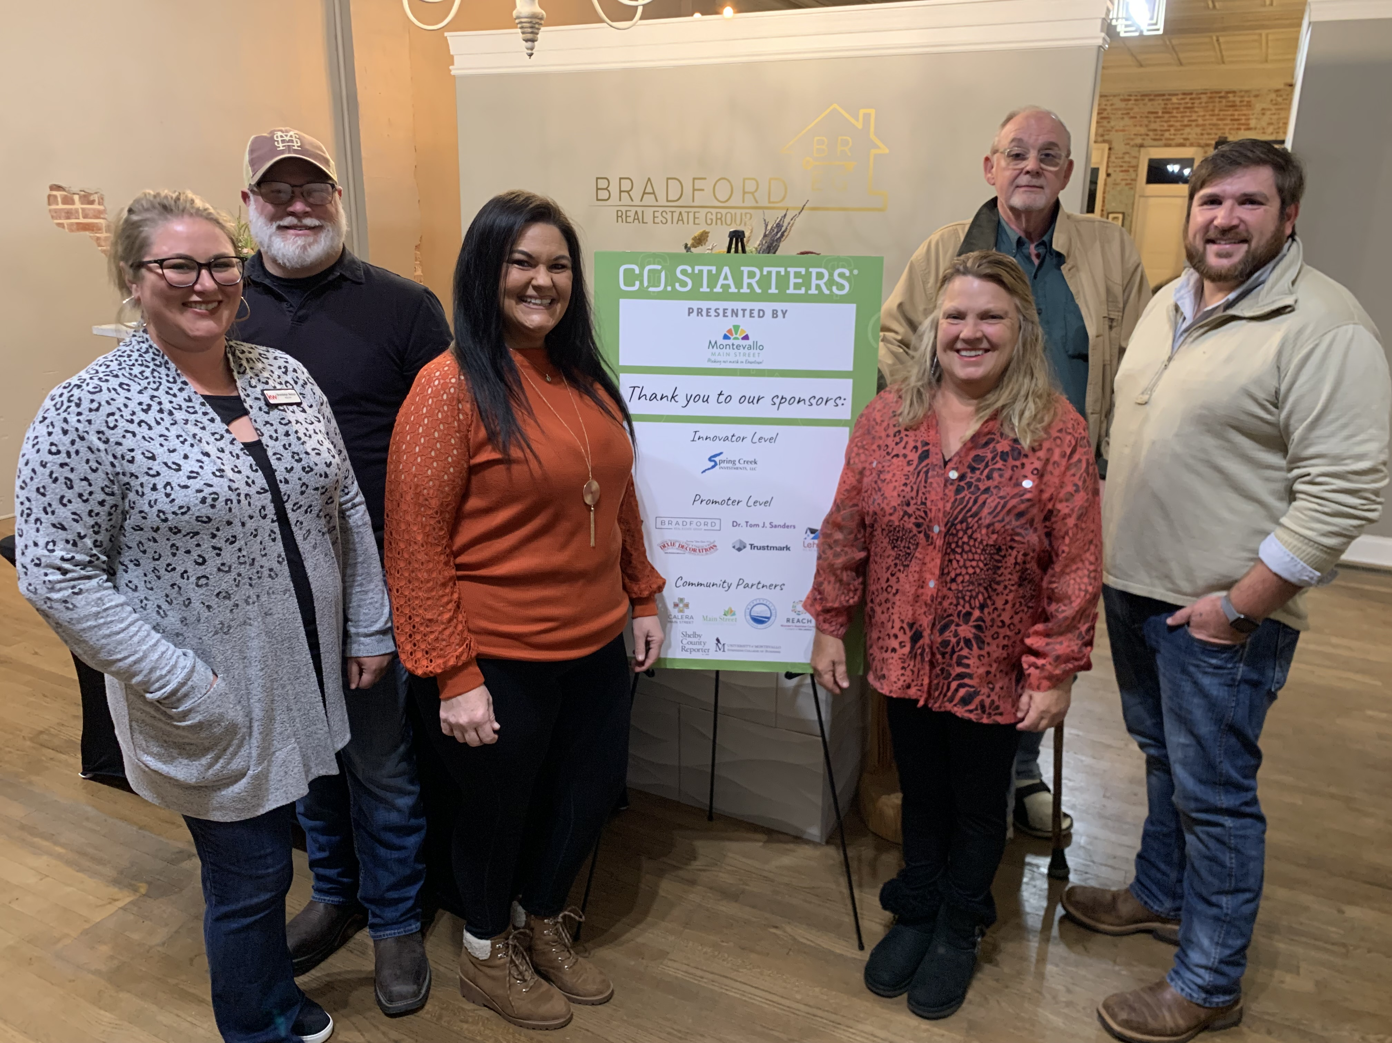
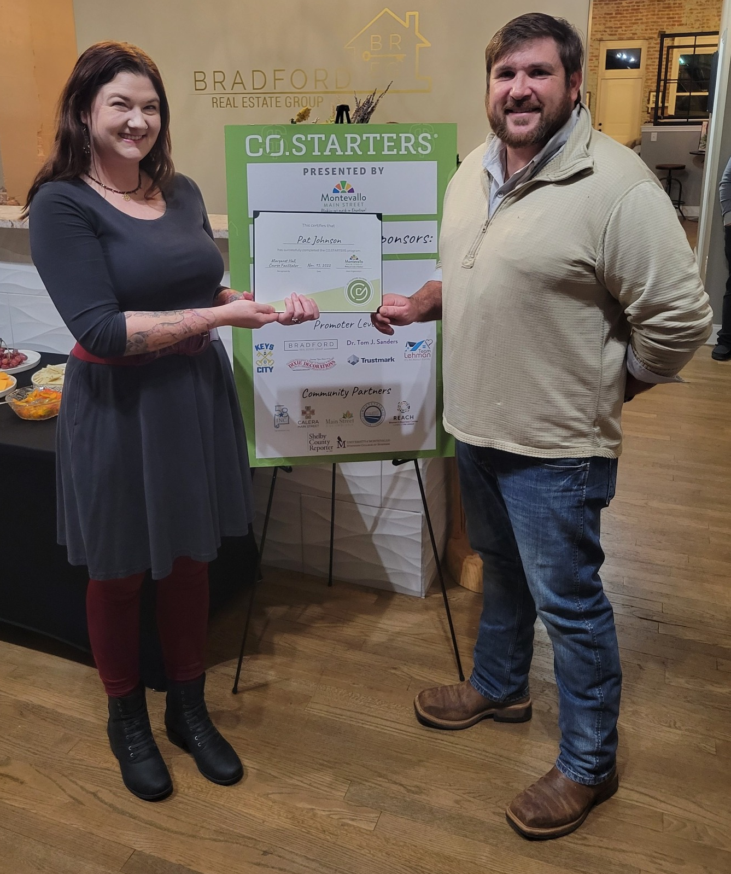
Montevallo∼ Local CO-STARTERS
In order to strengthen the entrepreneurial ecosystem in Shelby County, Montevallo Main Street partnered with CO-STARTERS to present a 9-week course for aspiring and new small business owners. The six Fall 2022 cohort graduates are all currently running small businesses spanning from building food trucks to real estate, to mead distilling, and more. The program helps entrepreneurs to develop and fine tune ideas, gaining a deeper understanding of how to create a sustainable business and bring their idea to life, make progress faster and with confidence, developing skills to understand the market and focus on the most critical activities needed to move forward, and receive real time feedback.

Slide 41
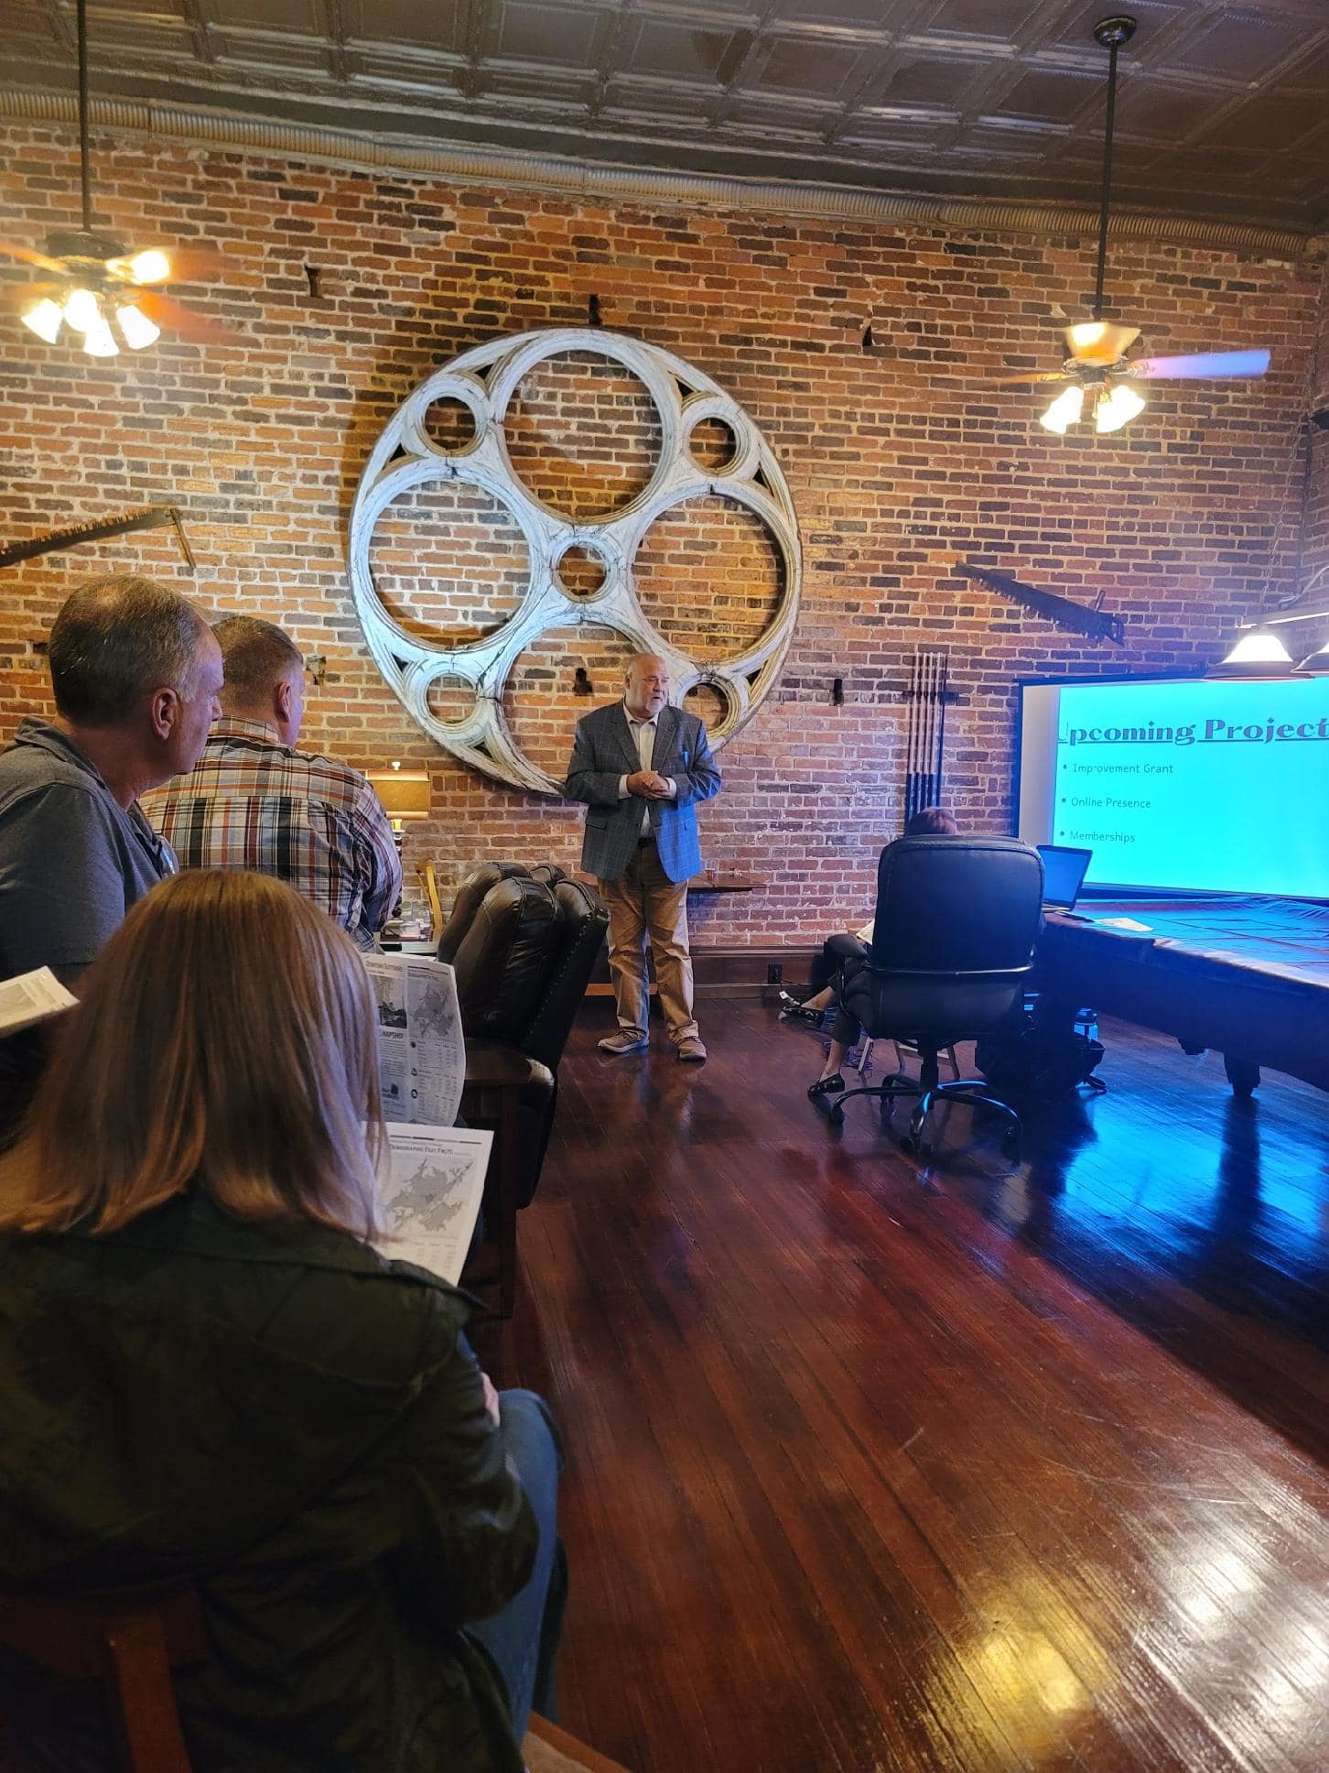
Scottsboro ∼ Networking Socials
The Downtown Scottsboro Networking Socials are a chance for the Main Street Scottsboro Board, business owners, building owners, and investors in the community to get together and discuss upcoming projects and events in the downtown and to provide resources for the stakeholders in the downtown to keep their businesses thriving or showcase opportunities for investment. The quarterly meetings are hosted by the Economic Vitality Committee. These meetings have successfully built better working relationships with the business and building owners in the downtown. The outcomes from this initiative have been better communication with businesses and purchasing of property in the downtown that will lead to more business development. Since the start of these meetings, four buildings have been purchased by new owners with the promise of renovation to include a new retail storefront.

Slide 42
Excellence in Placemaking
This award recognizes outstanding local efforts that capitalize on local assets, inspiration, and potential, with the intention of creating public spaces that promotes people’s health, happiness, and well being.

Slide 43
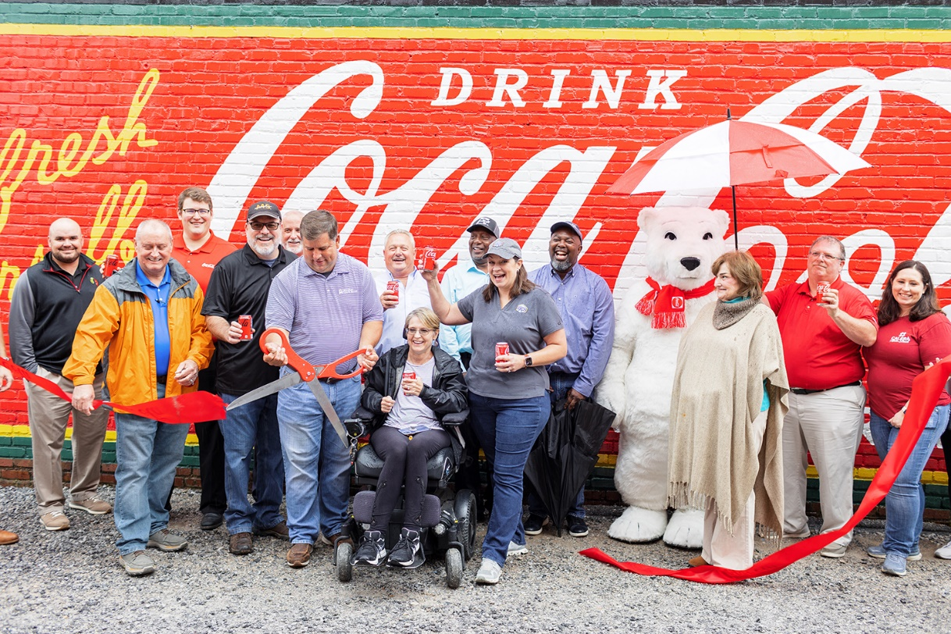
Calera ∼ Coca-Cola Mural Restoration
Coca-Cola Bottling Company United partnered with Calera Main Street to restore an old Coke advertisement mural. The historic mural was recreated to match the ghost images left from the 1930s and other murals from the same era in the Southeast. Coke helped with the research, secured the artist, and not only restored the historic mural but added the Calera Courtyard logo and a first of its kind (in Ala.) selfie-spot. Coca-Cola also brought in their PR agency to help with the dedication event, garnered additional media attention, and produced a professional video reel for Calera Main Street.

Slide 44
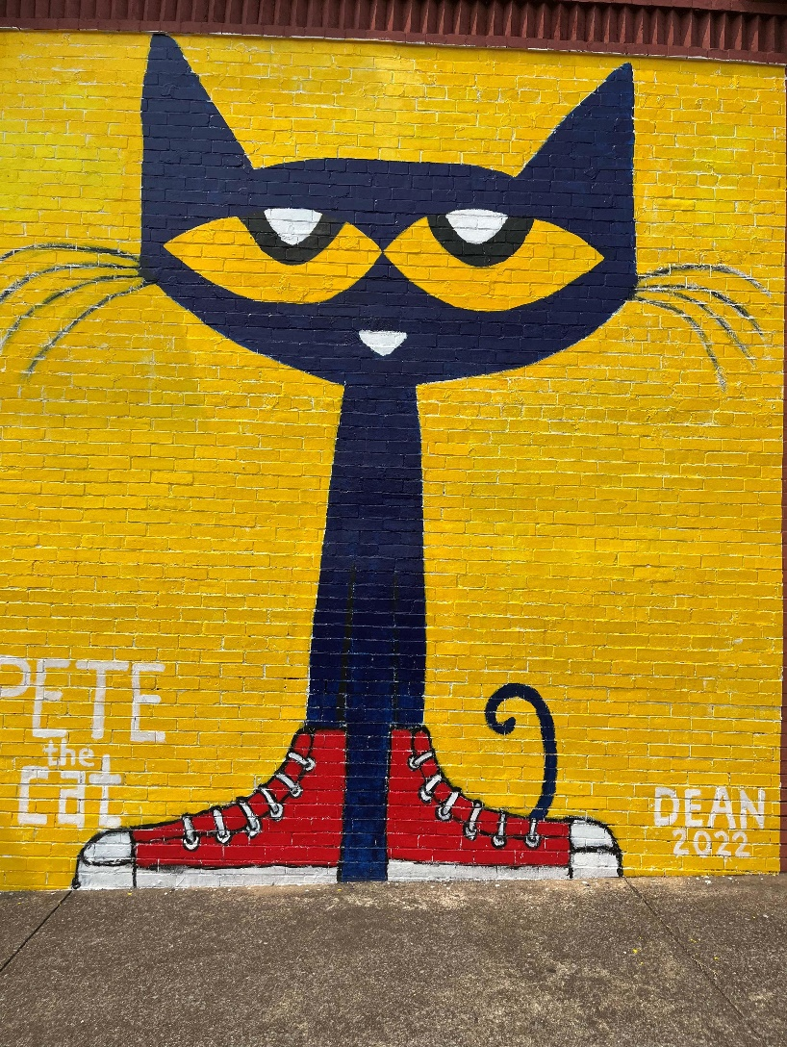
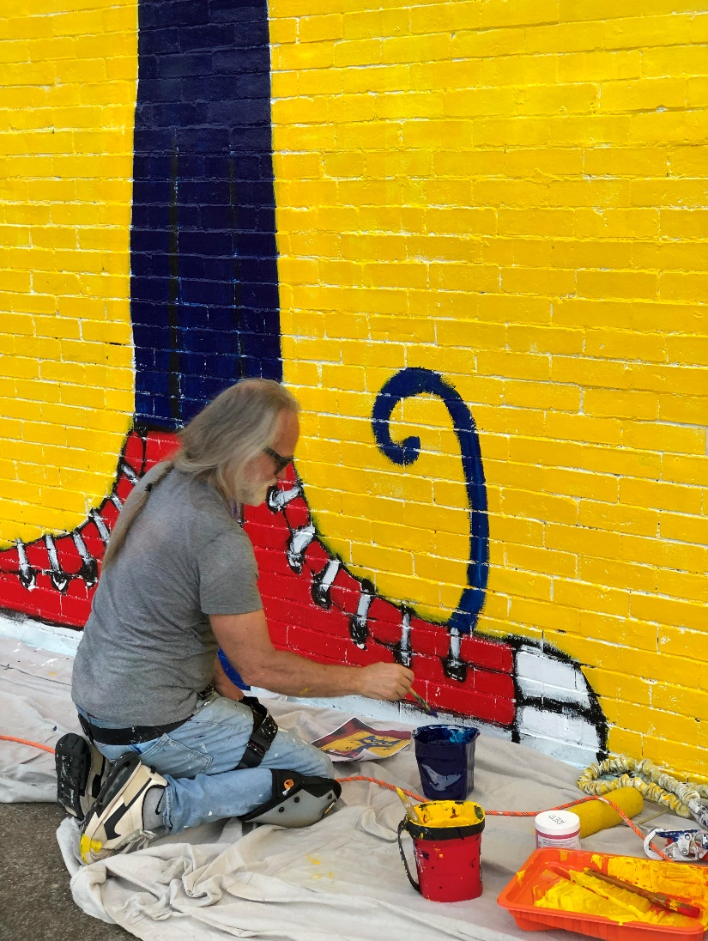
Fort Payne ∼ Pete the Cat Mural
James Dean, the creator of Pete the Cat wanted to do something special for Fort Payne Main Street and for his hometown. He developed a couple of ideas for a mural. He wanted to paint the largest Pete the Cat mural in the world. He shared his ideas and sketches with the director of Fort Payne Main Street. He painted the mural in two days. Mr. Dean paid for everything and did all of the labor. It's a wonderful mural and a beautiful gift for our Main Street. The artwork is priceless!
Before
After

Slide 45
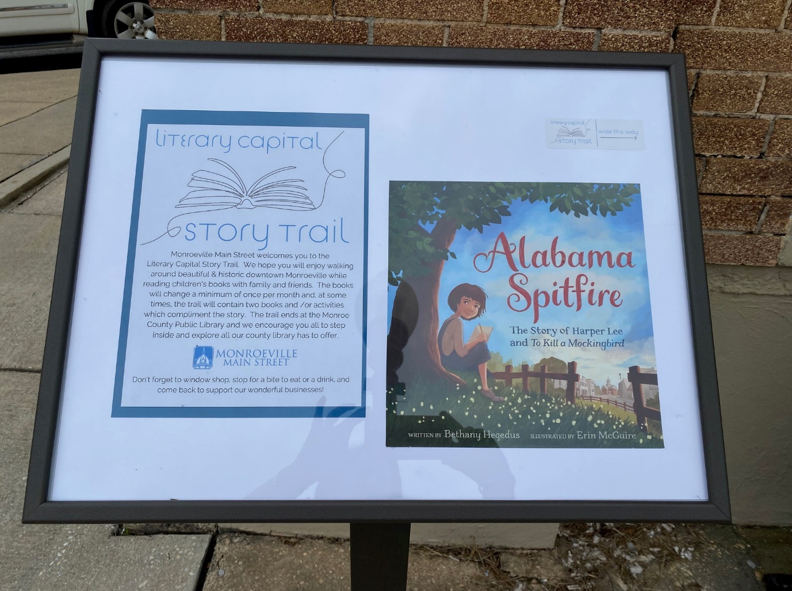
Monroeville ∼ Literary Capital Story Trail
The 24 panel Story Trail takes you on a walk around the historic Monroeville square starting at the Monroeville Main Street office and ending at the Monroe County Public Library. The story changes monthly (sometimes more) and combines education and exercise in a free multi-generational project for locals and tourists alike. By taking people around the entire square, they stroll by all the shops, restaurants, and businesses finding new items and services which increases the traffic and sales numbers downtown!
Before
After

Slide 46
Montevallo ∼ Mark Your Mark Youth Banner Project
To instill pride in young people growing up in Montevallo and to promote the arts, Montevallo Main Street partnered with Impact Montevallo to create a new downtown banner series featuring original artwork by local children. Banners were first displayed downtown in October 2022 and are now part of our regular banner rotation. This project involves youth and their families, adding to the foot traffic in the district.
Before
After

Slide 47
Excellence in Building Design
Award recognizes outstanding completed non historic design projects including façade renovation and/or interior renovation efforts and infill construction.

Slide 48
Athens ∼ Market & Monroe
Market & Monroe is an adaptive reuse project located in downtown Athens that revitalized a long-abandoned pool hall into a premiere event venue. The Whitfield family were among the first movers to embrace the revitalization of this neglected downtown building in quite some time. Market data produced by the Athens 2040 comprehensive plan showed that the downtown area is primed for such a venture, and the late 1800’s structure is now one of the first to receive such treatment. To rehab the building into a modernized event venue, the owners worked with local architecture firm, AMBL studios, and underwent a complete gut rehab of the structure and space, and a complete tear down and restoration of the storefront facade in order to address the failing structural members and restore the original historic detailing that had long been covered up. Acquisition, design, and construction put total cost of this project at approximately $1 million.
Before
After
After

Slide 49
Elba ∼ Wood Accounting
Wood Accounting was located outside the Elba downtown district in an outlying Shopping Center when some building issues caused Melissa Wood to decide to move to a new location. She chose the Square in Downtown Elba. She bought one building in the Downtown Main Street District and renovated. Then she felt led to purchase three other buildings and redo those. In the span of a year Melissa Wood has made a decrepit area come alive with business and activity. Truly an outstanding addition to Elba's Downtown.

Slide 50
Jasper ∼ Elle Luxe
After
From contemporary church to spa...and what a feat that was. Located next to a bustling restaurant in Downtown Jasper, this spa is now the place to go for rest and restoration. The building housed a church that had been declining in attendance and had become run down causing concern for the nearby restaurant. Lily Drummond bought the rundown building after the church closed and turned it into a spa. Approximately $250,000 was spent to transform this former problem building into a beautiful spa.

Slide 51
Monroeville ∼ Lofts at 41
After
Before
JWJ Company purchased the 1860's jail and gave the building a new purpose - the Lofts at 41. The Lofts at 41 has two luxury furnished apartments & a deck on the upper floor and Prodigy, a custom personal wellness center with small event space on the ground floor. Great care was taken to preserve the exterior facade while creating a seamless transition to the repurposed interior. The $750,000 construction project began by uncovering the original facade which gave the architect a view of the original door frames to access all the spaces seamlessly. The Milsap loft has a preserved drawing on the wall in the laundry room which is believed to be the work of a former prisoner and captures likeness of Judge Milsap.

Slide 52
Excellence in Planning and Public Spaces
Award recognizes outstanding planning projects and quality, completed design improvement projects such as streetscape, public spaces, etc.

Slide 53
Anniston ∼ Noble Street Park
With plans in place for a new City Market, City Hall moving back downtown, as well as a becoming downtown entertainment district, the Noble Street Park was built to serve as the perfect connecting piece among all the current and forthcoming downtown amenities. The project took place in what was a parking lot and after many months of planning and work they now have a beautiful park, fit for entertainment, private rentals, and many more Main Street Anniston events. In a word, it is the reverse of the famous Counting Crows song, instead of paving paradise for a parking lot, they built a small paradise in downtown Anniston!

Slide 54
Eufaula ∼ Eufaula Children’s Plaza
Barbour County Extension had funds leftover from the ALPRO grant and the downtown restroom facility was on the short list of necessities. Everything from brick, style, fixtures, fencing, et cetera were decided upon by the design committee, approved by the Eufaula City Council as the newest council's first project, something to be proud of! Events will be a lot easier with the convenience of the beautiful new addition. Several elements were added to complement the district downtown including a cupola and custom wrought iron fencing. With rising temperatures during the summer, this also doubles as a cooling off area for infants and senior adults. Restrooms and changing area are air conditioned. A wonderful addition to their downtown district.

Slide 55
Foley ∼ Pine Street Pocket Park
Pine Street Pocket Park began as a dream of the City of Foley Beautification Committee to place a marker on a lot where the old Foley Methodist Church used to be. In partnership with Baldwin County Board of Education who leased the land to the City, the City created an outdoor auditorium to be used by the schools, and for the community to enjoy. Foley Main Street received a $20,000 AARP community grant for the outdoor musical instruments located at the back of the handicapped accessible stage. What started out as a minor project blossomed into the city committing and spending over 600,000 for the park. The City of Foley worked with WAS Designs and Foley Main Street to create a beautiful entry into the district.

Slide 56
Excellence in Historic Rehabilitation
Award recognizes outstanding historic rehabilitation projects that continue the economic use of the building. The project is located in the district and includes exterior rehabilitation work or both interior and exterior work and meets Secretary of Interior Standards for Rehabilitation.

Slide 57
Atmore ∼ Pride of Atmore’s ”Save the Strand” Project
In Progress
When the Strand Theatre closed for first run movies in 2013, it was the longest running theater in the state of Alabama. Purchased by the nonprofit organization; The Pride of Atmore in 2014, the goal initially was to add a coat of paint and a few upgrades to the facility and call it done. While the cry “Save the Strand” resonated throughout Atmore for 2014 and 15 it soon became apparent that it was going to take more than a coat of paint, like a new roof! Dedicated to preserving and protecting the historical legacy of downtown Atmore, the Pride of Atmore's mission of historically restoring the century old Strand Theatre and 125-year-old adjacent Hardware Store was completed this spring after nine-years of renovation work and fundraising. Meeting the underserved community's critical infrastructure needs, the two restored facilities serve as the primary focal point of a multi-faceted Arts, Education, and Technology and Cultural Center and has enhanced the quality of life in Atmore and the surrounding communities, serving as the ART & SOUL of Atmore Main Street.
Before
After
After

Slide 58
Decatur ∼ Citizens Bank
This bank building had experienced major deferred maintenance, water leaks, plaster damage, with minimal updates for the last 30 years. This project brought the building back to its original glory. Aesthetic rehabilitation of the interior of the building included: painting, sheetrock, molding, updating the plumbing and electrical. The breakroom and bathrooms were renovated, and a glass conference room was Installed along with new half wall cubicle walls. The original safe is now open for bank guests to step inside and tour. This project has been a fantastic way to truly bring a downtown building back to its original splendor. Steve Armistead and Yogi Dougher were able to keep the iconic wrap around balcony, marble flooring, and original facade. They coordinated the buildout with their new tenant Citizens Bank that opened its first Decatur branch in February 2023. This project has taken a forgotten piece of downtown history and revived it to a present-day bank so that clients and passersbys on the sidewalk can enjoy and appreciate this magnificent building again.
Before
After

Slide 59
Enterprise ∼ Pea River Historical Society Façade Improvement
The facade renovation of the Pea River Historical Society Gift Shop and Research Library was a project to repair, revive, and restore a 118-year-old historic storefront. While repairs were the immediate need, the outdated design of the facade was also in desperate need of a revival and new life. The most striking part of the rehab was the removal of the metal siding that covered the entire facade from awning to the roof. Revealed under the beige metal was the original 1904 brick that was painted green over 50 years ago. Immediately upon the reveal, residents and business owners wanted to know what the lettering said and begged for the brick to remain exposed. New lighting was installed to highlight the brick detailing and a new round sign was placed for the Historical Society. This project returned the building to the original configuration and restored the historic integrity of a property in the heart of downtown.
Before
After

Slide 60
Foley ∼ Hollis Interiors
Hollis Interiors takes up almost an entire block on Hwy 59 leading into Downtown Foley. This building was constructed by the George C. Randolph company for the Orange Crush Bottling Company in 1922. The current owners decided to move forward preserving and revitalizing their building, which they have owned since 1952. For work to be approved on a historic building in the district, it must conform to the Secretary of Interior Standards for Rehabilitation. One issue that arose was the painting of brick. Two experts were brought in to review the project. It was proven that the bricks had been painted in the past and sandblasted in the 70s, which ruined the brick. The brick not only had to be repointed, but it also had to be painted to save the brick from further deterioration. It was a decision of the Foley Historic Commission that this did not ruin the historic integrity of the building. The windows were uncovered when the signs were taken down. The Hollis’s fixed the windows and left them exposed. The project consisted of removal of signs, making repairs to exposed windows, caulk, and paint. Repoint and repair mortar, paint brick and mortar, and replace front doors. They also purchased and installed new signs and awnings.
Before
Before
After
After

Slide 61
Excellence in Adaptive Reuse
Award recognizes the best adaptive reuse of a building that has outlived its former use, including conversions to housing and office space, multiple businesses, public meeting space, restaurants, cultural centers, etc.

Slide 62
Gadsden ∼ Etowah County Board of Education
Before
The property located at 4th and Broad Streets had been the home to Colonial Bank and then BB&T Bank for 10 years. When the bank left the downtown district to move to a different area, the property was placed on the market. In December 2020, the Etowah County Commission purchased the property to consolidate employees of the Etowah County Board Education. The employees were in two cities, and this allowed them to be merged into one location which served as a more centralized location. The grand opening was held October 18, 2022. The purchase of the property and subsequent renovation will be beneficial to the historic district. The number of employees at the bank had dropped to 8 at the time they moved, and the Etowah County Board of Education brought 60 employees. You can see many of these employees out shopping and dining during the day.

Slide 63
Excellence in Design Development
This award recognizes a local Main Street program, business, municipality, or other organization that provides tools and resources to spur reinvestment in historic properties.

Slide 64
Atmore ∼ Façade Grant Incentive Program
The Main Street Atmore Façade Incentive Program is the driving force behind efforts with preservation and maintenance of historic properties in the district. The coordinated, small-scale façade improvements have not only preserved valuable historic resources in Atmore but have also triggered economic growth. With new and improved "facelifts,” downtown businesses have reported tangible economic benefits by increasing sales of local businesses. With the growing number of transformative projects, other businesses observed “first-hand” the importance of preserving significant architectural assets with the façade grants to the business and building owners.
In 2023, Main Street Atmore assisted over 40 buildings or businesses and distributed $97,329 of $324,770.71 which does not include the Pride of Atmore’s $5 million dollar Strand and Encore project. In the 2022 Façade Grant cycle, they distributed $44,351.24 out of $133,691.13 in total improvement project costs. The program is funded through various fundraising events like Celebrity Waiter, memberships, grants, sponsorship investments provided by the City of Atmore, Poarch Creek Indians, First National Bank and Trust, Gulf Winds Federal Credit Union, United Bank, David’s Catfish and Pepsi-Cola Bottling Company of Atmore.
Before
After

Slide 65
Excellence in Tourism
This award recognizes outstanding local efforts in the development of tourism campaigns that promote history and preservation.

Slide 66
Marion ∼ Alabama Civil Rights Trail
Main Street Marion invited Alabama State Tourism Director Lee Sentell to meet with their civil rights coalition in May of 2023. He expressed his great interest in seeing Marion expand the civil rights tourism footprint. He acknowledged Marion’s significant contribution to the story of the 1965 Voter’s Rights Act and pledged to be a positive force in the plan for creating a more viable civil rights tourist destination in Marion. Alabama Tourism assisted Main Street Marion and the Marion Art Center in providing Civil Rights exhibits, events, classes and services to our local community. Marion has now been added to the Alabama Tourism Civil Rights Trail.
Before
After

Slide 67
Excellence in Reinvestment
Beginning in June of a communities’ designation as a Main Street Alabama program, programs collect and submit the economic impact within the district. Main Street Alabama utilizes those reports to track grand totals for each district and the state as a whole. Now we will recognize Main Street Alabama programs that have reached major milestones in reinvestment.

Slide 68
Over $1 Million

Slide 69
Scottsboro
pop. 15,640
$1,159,895
Since June 2018
PRIVATE INVESTMENT
PUBLIC INVESTMENT
$1,234,550
$325,345
NEW BUSINESSES
JOBS CREATED
VOLUNTEER HOURS
5
18
2,231
Presented by

Slide 70
Elba
pop. 3,401
$1,330,952
Since June 2015
PRIVATE INVESTMENT
PUBLIC INVESTMENT
$1,100,196
$230,756
NEW BUSINESSES
JOBS CREATED
VOLUNTEER HOURS
21
52
7,141
Presented by

Slide 71
Atmore
pop. 8,542
$2,933,363
Since June 2020
PRIVATE INVESTMENT
PUBLIC INVESTMENT
$2,204,947
$728,416
NEW BUSINESSES
JOBS CREATED
VOLUNTEER HOURS
19
37
1,476
Presented by

Slide 72
Over $3 Million

Slide 73
Demopolis
pop. 7,009
$3,756,900
Since June 2022
PRIVATE INVESTMENT
PUBLIC INVESTMENT
$855,000
$2,901,900
NEW BUSINESSES
JOBS CREATED
VOLUNTEER HOURS
5
13
732
Presented by

Slide 74
Columbiana
pop. 4,263
$3,778,356
Since June 2016
PRIVATE INVESTMENT
PUBLIC INVESTMENT
$870,260
$2,908,096
NEW BUSINESSES
JOBS CREATED
VOLUNTEER HOURS
11
23
2,552
Presented by

Slide 75
Enterprise
pop. 29,395
$4,186,312
Since June 2019
PRIVATE INVESTMENT
PUBLIC INVESTMENT
$2,615,735
$1,570,578
NEW BUSINESSES
JOBS CREATED
VOLUNTEER HOURS
22
77
4,487
Presented by

Slide 76
Calera
pop. 17,414
$4,338,440
Since June 2019
PRIVATE INVESTMENT
PUBLIC INVESTMENT
$2,820,740
$1,517,700
NEW BUSINESSES
JOBS CREATED
VOLUNTEER HOURS
10
21
6,023
Presented by

Slide 77
Over $5 Million

Slide 78
Fort Payne
pop. 14,834
$5,643,188
Since June 2015
PRIVATE INVESTMENT
PUBLIC INVESTMENT
$5,285,288
$357,900
NEW BUSINESSES
JOBS CREATED
VOLUNTEER HOURS
24
72
10,135
Presented by

Slide 79
Eufaula
pop. 12,675
$6,921,814
Since June 2014
PRIVATE INVESTMENT
PUBLIC INVESTMENT
$5,275,834
$1,645,980
NEW BUSINESSES
JOBS CREATED
VOLUNTEER HOURS
31
105
2,443
Presented by

Slide 80
Alexander City
pop. 14,618
$8,291,365
Since June 2014
PRIVATE INVESTMENT
PUBLIC INVESTMENT
$6,885,465
$1,405,900
NEW BUSINESSES
JOBS CREATED
VOLUNTEER HOURS
32
-36
9,712
Presented by

Slide 81
Monroeville
pop. 5,841
$8,442,455
Since June 2014
PRIVATE INVESTMENT
PUBLIC INVESTMENT
$8,222,365
$220,090
NEW BUSINESSES
JOBS CREATED
VOLUNTEER HOURS
37
63
6,208
Presented by

Slide 82
Wetumpka
pop. 7,190
$9,434,846
Since June 2016
PRIVATE INVESTMENT
PUBLIC INVESTMENT
$3,989,627
$5,445,219
NEW BUSINESSES
JOBS CREATED
VOLUNTEER HOURS
49
103
5,653
Presented by

Slide 83
Over $10 Million

Slide 84
Foley
pop. 22,063
$10,614,192
Since June 2018
PRIVATE INVESTMENT
PUBLIC INVESTMENT
$8,972,274
$1,641,918
NEW BUSINESSES
JOBS CREATED
VOLUNTEER HOURS
44
67
3,832
Presented by

Slide 85
Oxford
pop. 22,312
$10,907,144
Since June 2014
PRIVATE INVESTMENT
PUBLIC INVESTMENT
$9,677,150
$1,229,993
NEW BUSINESSES
JOBS CREATED
VOLUNTEER HOURS
7
108.5
4,089
Presented by

Slide 86
Montevallo
pop. 7,229
$14,344,612
Since June 2016
PRIVATE INVESTMENT
PUBLIC INVESTMENT
$8,585,872
$5,758,740
NEW BUSINESSES
JOBS CREATED
VOLUNTEER HOURS
23
39
15,979
Presented by

Slide 87
Heflin
pop. 3,431
$19,781,211
Since June 2016
PRIVATE INVESTMENT
PUBLIC INVESTMENT
$18,538,303
$1,242,908
NEW BUSINESSES
JOBS CREATED
VOLUNTEER HOURS
12
60
4,730
Presented by

Slide 88
Over $20 Million

Slide 89
4th Avenue Business District - Birmingham
$21,881,366
Since June 2019
PRIVATE INVESTMENT
PUBLIC INVESTMENT
$13,809,886
$8,071,480
NEW BUSINESSES
JOBS CREATED
VOLUNTEER HOURS
17
28
754
Presented by

Slide 90
Jasper
pop. 14,354
$22,943,378
Since June 2015
PRIVATE INVESTMENT
PUBLIC INVESTMENT
$19,426,025
$3,517,353
NEW BUSINESSES
JOBS CREATED
VOLUNTEER HOURS
57
313
6,970
Presented by

Slide 91
Gadsden
pop. 103,931
$23,756,199
Since June 2014
PRIVATE INVESTMENT
PUBLIC INVESTMENT
$23,494,499
$261,700
NEW BUSINESSES
JOBS CREATED
VOLUNTEER HOURS
30
192
3,404
Presented by

Slide 92
Over $30 Million

Slide 93
Opelika
pop. 26,477
$39,629,756
Since June 2014
PRIVATE INVESTMENT
PUBLIC INVESTMENT
$20,093,949
$19,535,808
NEW BUSINESSES
JOBS CREATED
VOLUNTEER HOURS
39
132
8,401
Presented by

Slide 94
Athens
pop. 27,027
$39,882,195
Since June 2014
PRIVATE INVESTMENT
PUBLIC INVESTMENT
$27,250,658
$12,631,537
NEW BUSINESSES
JOBS CREATED
VOLUNTEER HOURS
24
131
15,065
Presented by

Slide 95
Over $50 Million

Slide 96
Anniston
pop. 21,157
$56,815,959
Since June 2014
PRIVATE INVESTMENT
PUBLIC INVESTMENT
$12,006,856
$44,809,103
NEW BUSINESSES
JOBS CREATED
VOLUNTEER HOURS
35
156
4,559
Presented by

Slide 97
Over $60 Million

Slide 98
Decatur
pop. 57,804
$63,265,121
Since June 2014
PRIVATE INVESTMENT
PUBLIC INVESTMENT
$24,510,924
$38,754,197
NEW BUSINESSES
JOBS CREATED
VOLUNTEER HOURS
43
288
1,721
Presented by

Slide 99
Over $80 Million

Slide 100
Florence
pop. 39,933
$80,358,069
Since June 2014
PRIVATE INVESTMENT
PUBLIC INVESTMENT
$72,731,383
$7,626,686
NEW BUSINESSES
JOBS CREATED
VOLUNTEER HOURS
197
616
6,374
Presented by

Slide 101
Over $200 Million

Slide 102
South Huntsville
$221,124,970
Since June 2018
PRIVATE INVESTMENT
PUBLIC INVESTMENT
$221,031,470
$93,500
NEW BUSINESSES
JOBS CREATED
VOLUNTEER HOURS
50
280
2,973
Presented by

Slide 103
Birmingham – Woodlawn, City Center
$289,413,168
Since June 2014
PRIVATE INVESTMENT
PUBLIC INVESTMENT
$284,784,025
$4,629,143
NEW BUSINESSES
JOBS CREATED
VOLUNTEER HOURS
189
624
6,842
Presented by

Slide 104
“I cannot do all the good that the world needs. But the world needs all the good that I can do.”
Jana Stanfield

